Slide 1


Industry LEVEL FORECAST
By Ananta Kumaar V R
under the Guidance of Srinidhi K J

Slide 2

PROJECT OBJECTIVE
EXPECTED BENEFITS
We try to bring together comprehensive techniques with hardware & software to offer complete and intelligible forecasts for Master Production Schedules.
Improved vehicle sales prediction accuracy
Proactive demand planning
Passenger Car sales is influenced by multiple factors; from organization driven drivers (like marketing, promotions, pricing , to macro-economic (inflation, GDP etc.)
Accurately measuring the impact of various sales drivers and their impact on future sales
The expectation from the Project is focused on developing a mathematical model which can identify demand drivers and use historical data to forecast sales with highest prediction accuracy.
SOLUTION OVERVIEW
Identify exhaustive list of factors impacting vehicle sales
Feature Engineering to Transform variables, impute missing variables, develop derived variables
Analytical Engineering to develop models by applying multiple mathematical techniques
Feature Selection to finalize features based on models with highest accuracy on out of sample data

Slide 3
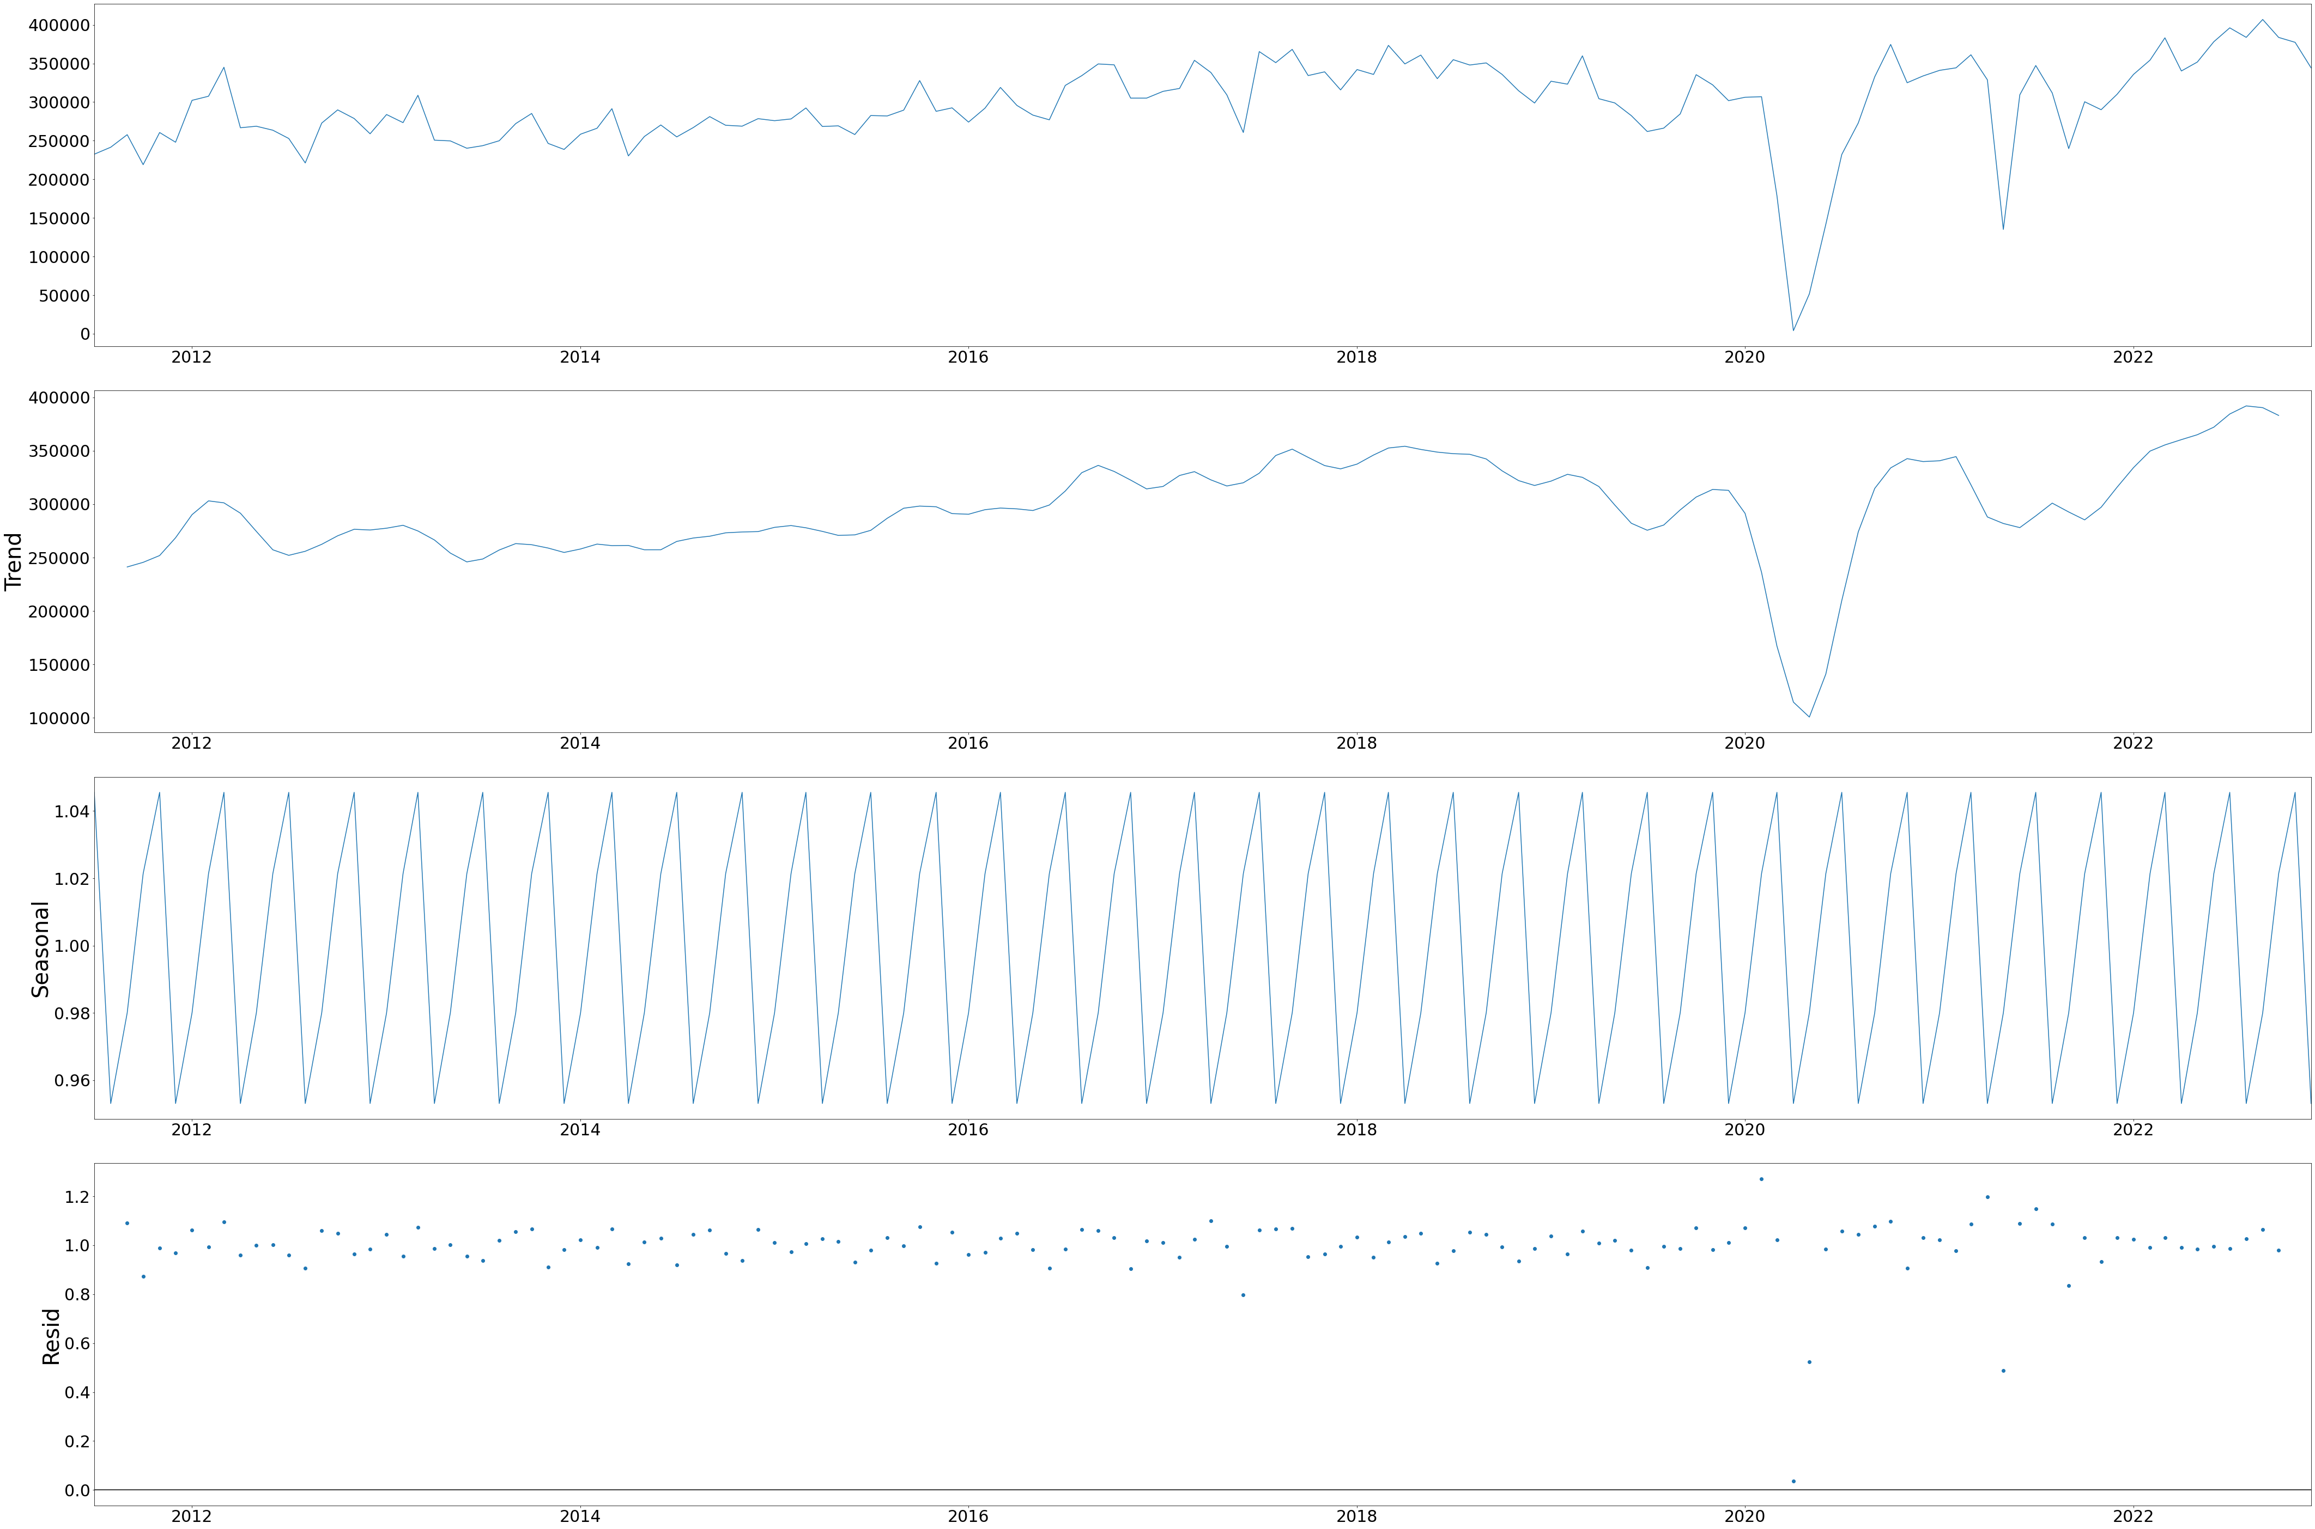
PC Sales plot against time during the process of data cleaning and EDA for model train

Slide 4
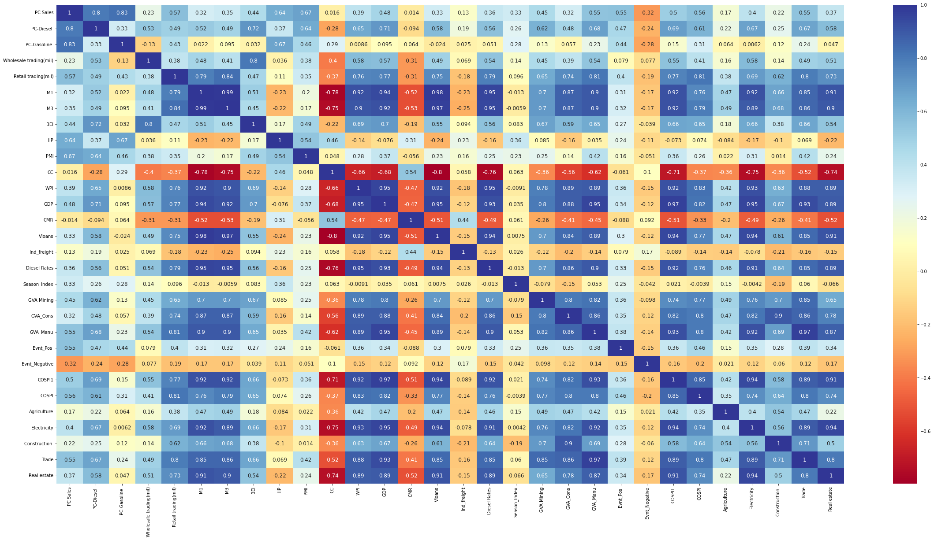
PC
Heat map for correlation between indicators before Feature importance analysis.

Slide 5
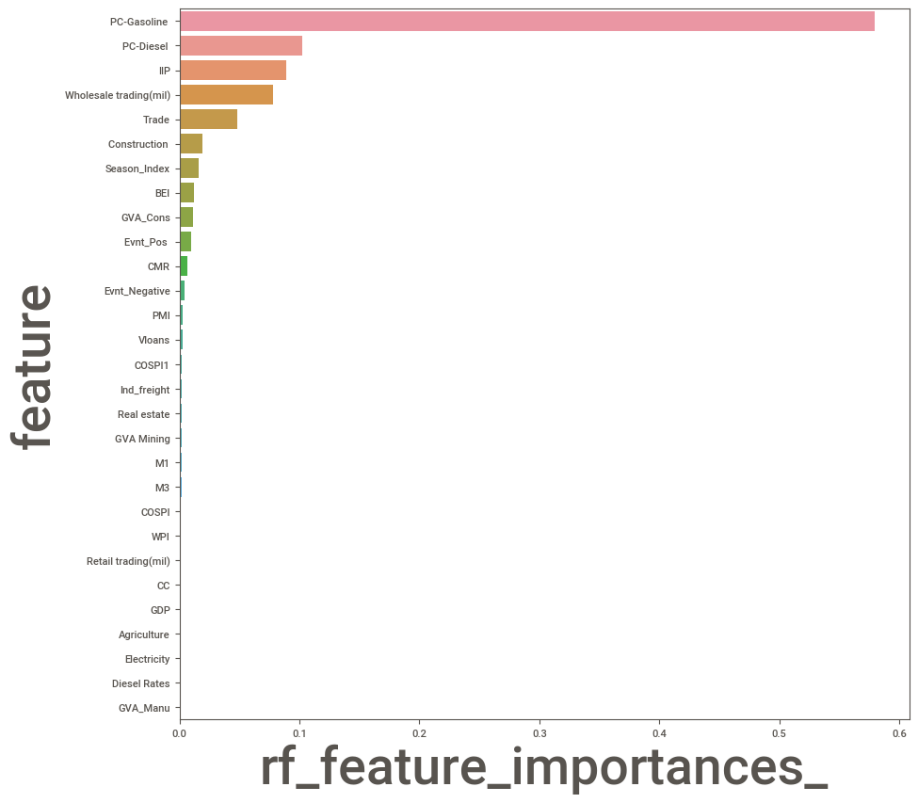
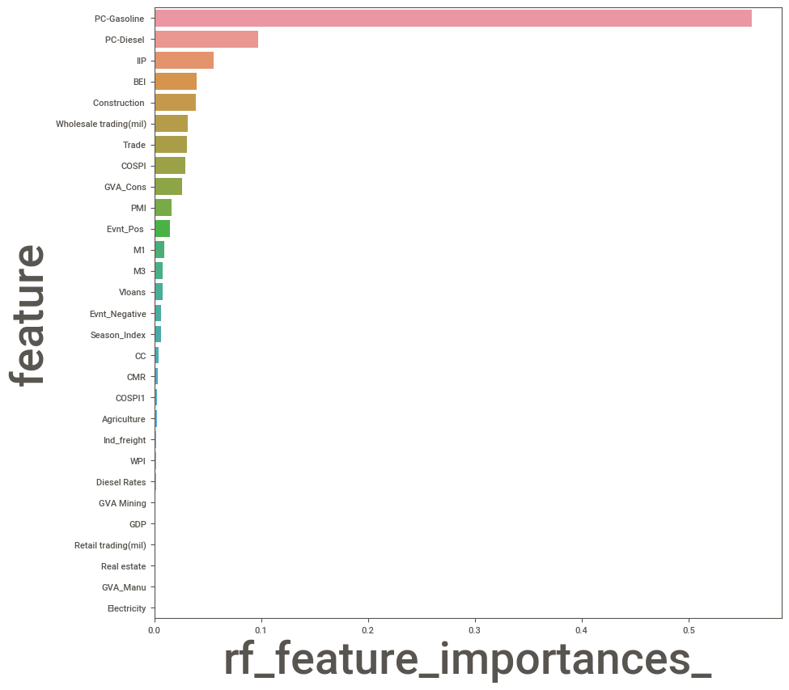
Comparison of number of indicators before and after feature importance analysis for PC

Slide 6
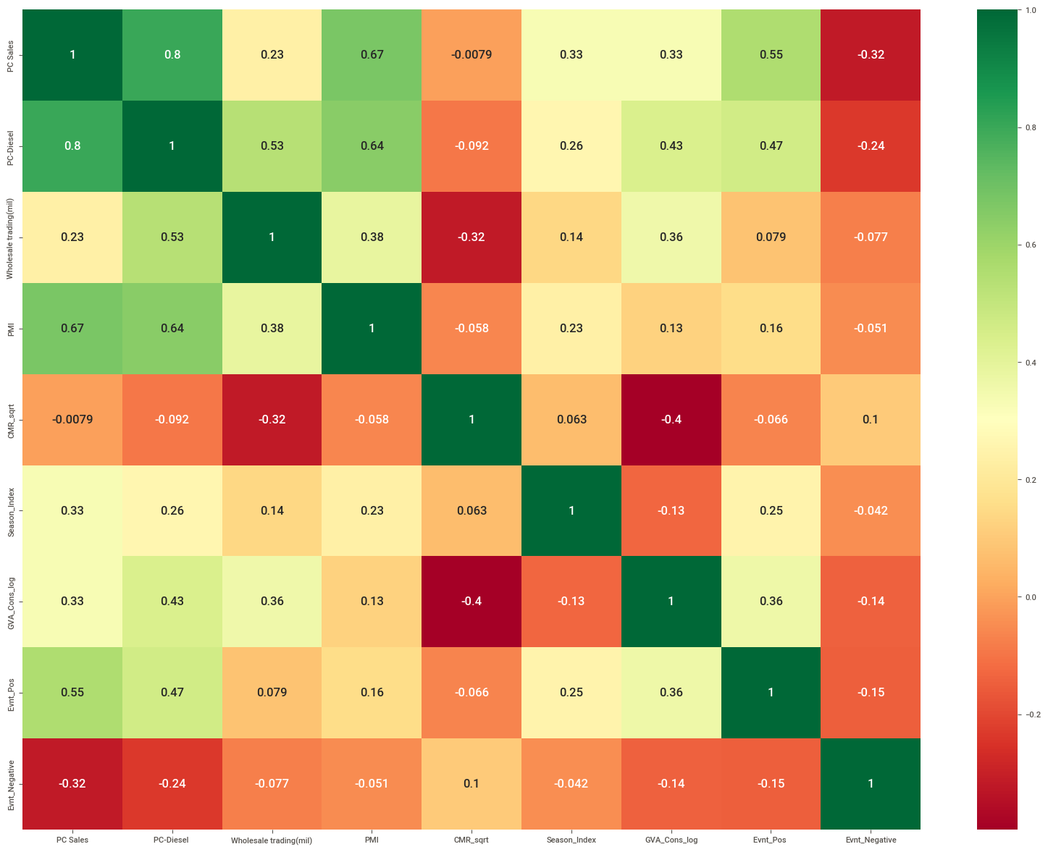
PC
Heat map for correlation between indicators after feature importance analysis with most correlated indicators filtered out.

Slide 7
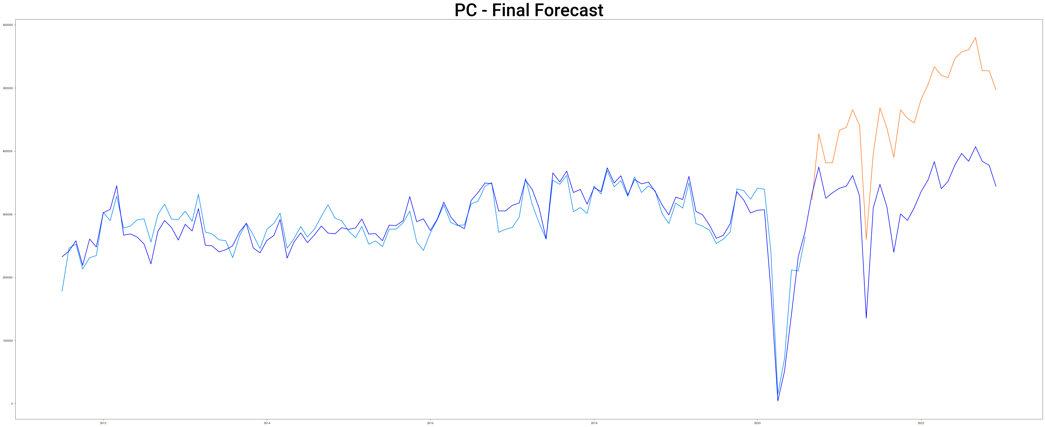
PC final forecast obtained from model

Slide 8
PC Monthly Sales Forecast Jan-2023 to Dec-2024

Slide 9
PC Quarterly Sales Forecast Jan-2023 to Oct-2024

Slide 10
Final Forecasted Sales figures of PC for Jan 2023- Dec 2024
Year-Quarter | Year-Month | Monthly Sales | Quarter Sales
2023-Q1 | 2023-01 | 393241 | 11,47,953
 | 2023-02 | 375584
 | 2023-03 | 379128
2023-Q2 | 2023-04 | 275299 | 8,72,178
 | 2023-05 | 273195
 | 2023-06 | 323684
2023-Q3 | 2023-07 | 317886 | 9,94,035
 | 2023-08 | 328570
 | 2023-09 | 347579
2023-Q4 | 2023-10 | 385071 | 10,43,830
 | 2023-11 | 330968
 | 2023-12 | 327791
Year-Quarter | Year-Month | Monthly Sales | Quarter Sales
2024-Q1 | 2024-01 | 348887 | 10,48,225
 | 2024-02 | 344615
 | 2024-03 | 354723
2024-Q2 | 2024-04 | 237343 | 7,27,468
 | 2024-05 | 226626
 | 2024-06 | 263499
2024-Q3 | 2024-07 | 311215 | 9,59,345
 | 2024-08 | 313699
 | 2024-09 | 334431
2024-Q4 | 2024-10 | 347561 | 9,98,079
 | 2024-11 | 328861
 | 2024-12 | 321657

Slide 11
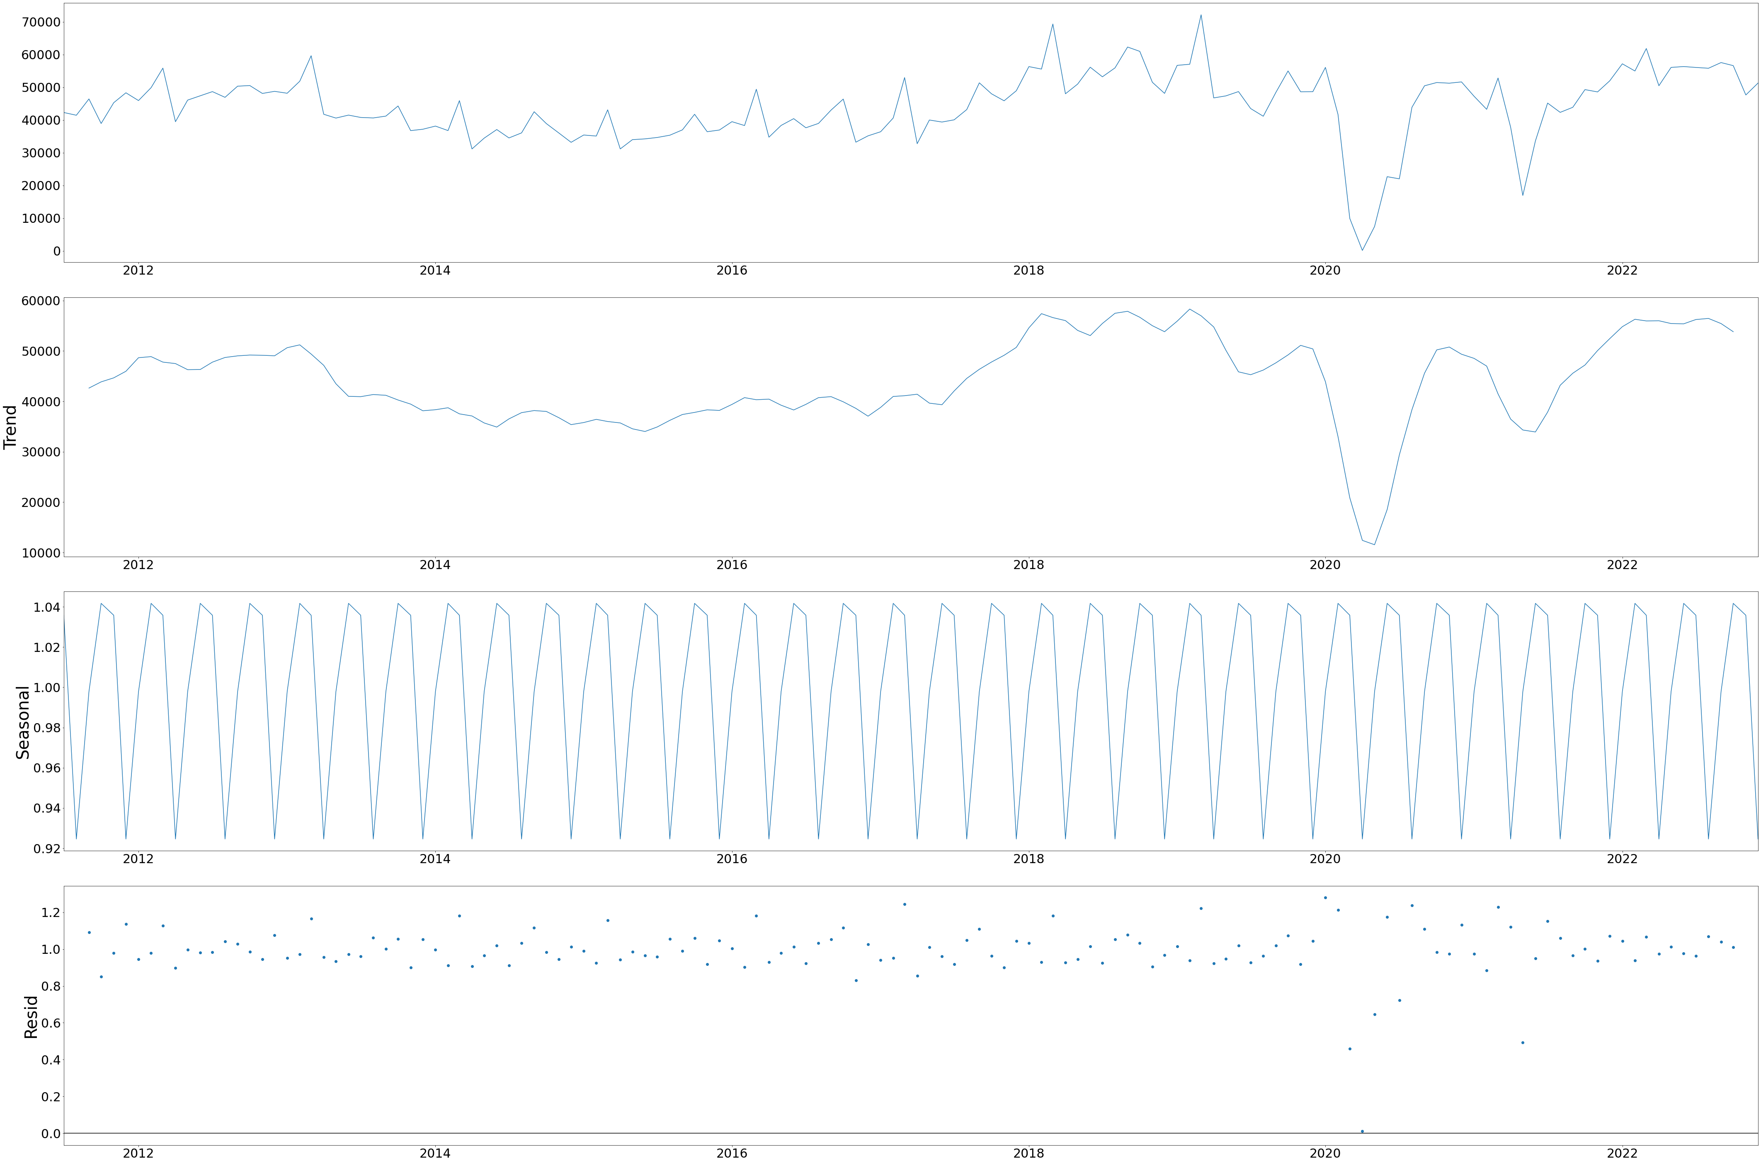
LCV Sales plot against time during the process of data cleaning and EDA for model train

Slide 12
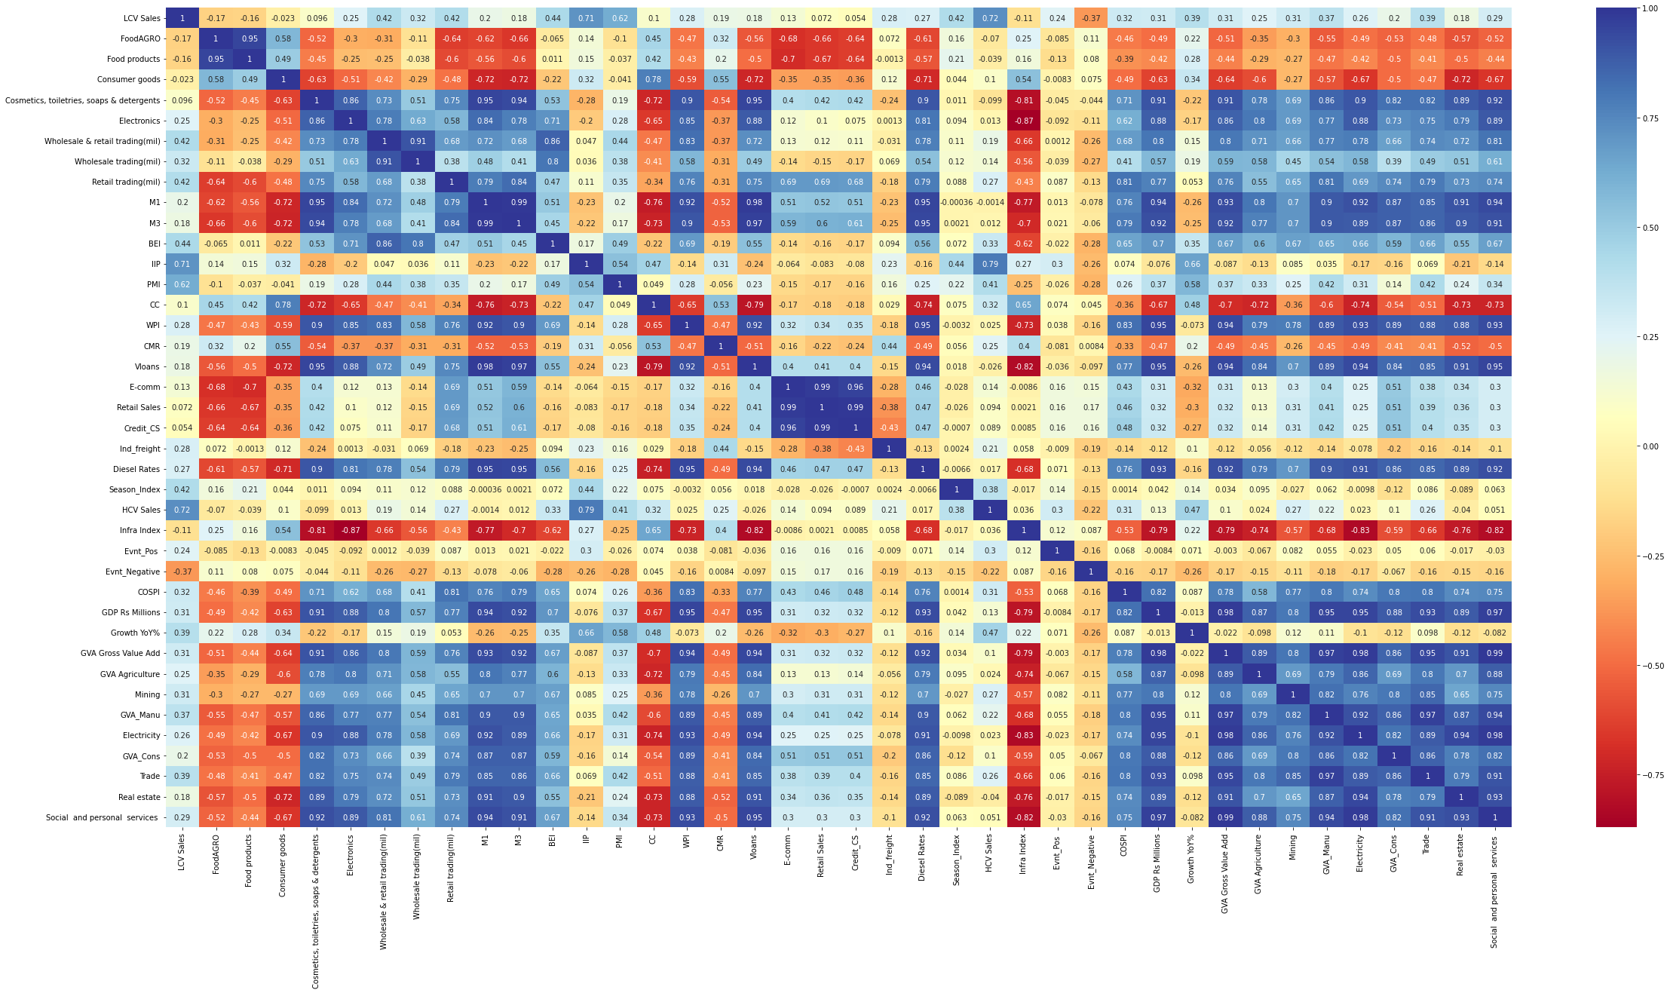
LCV
Heat map for correlation between indicators before Feature importance analysis.

Slide 13
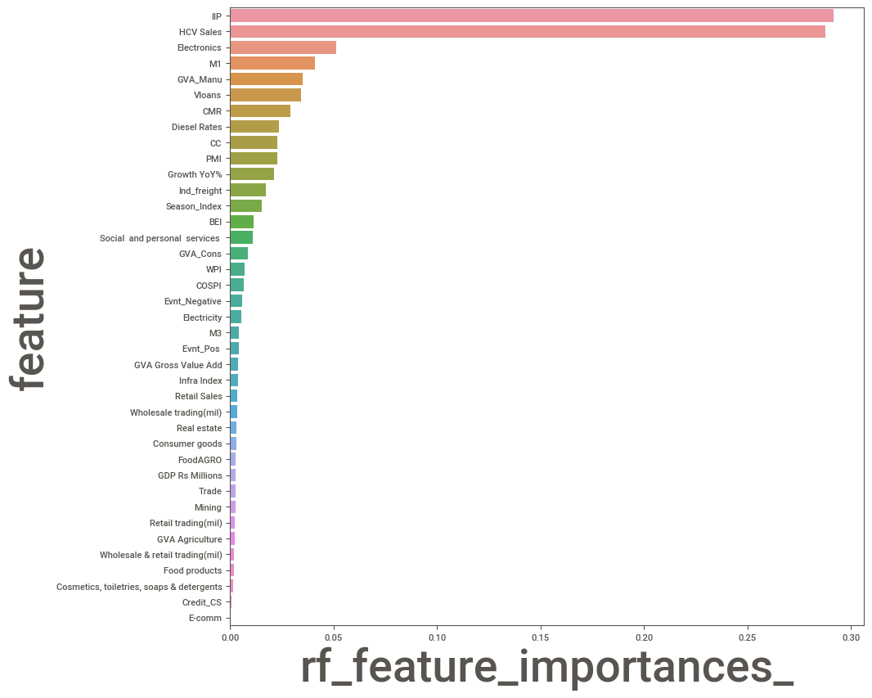
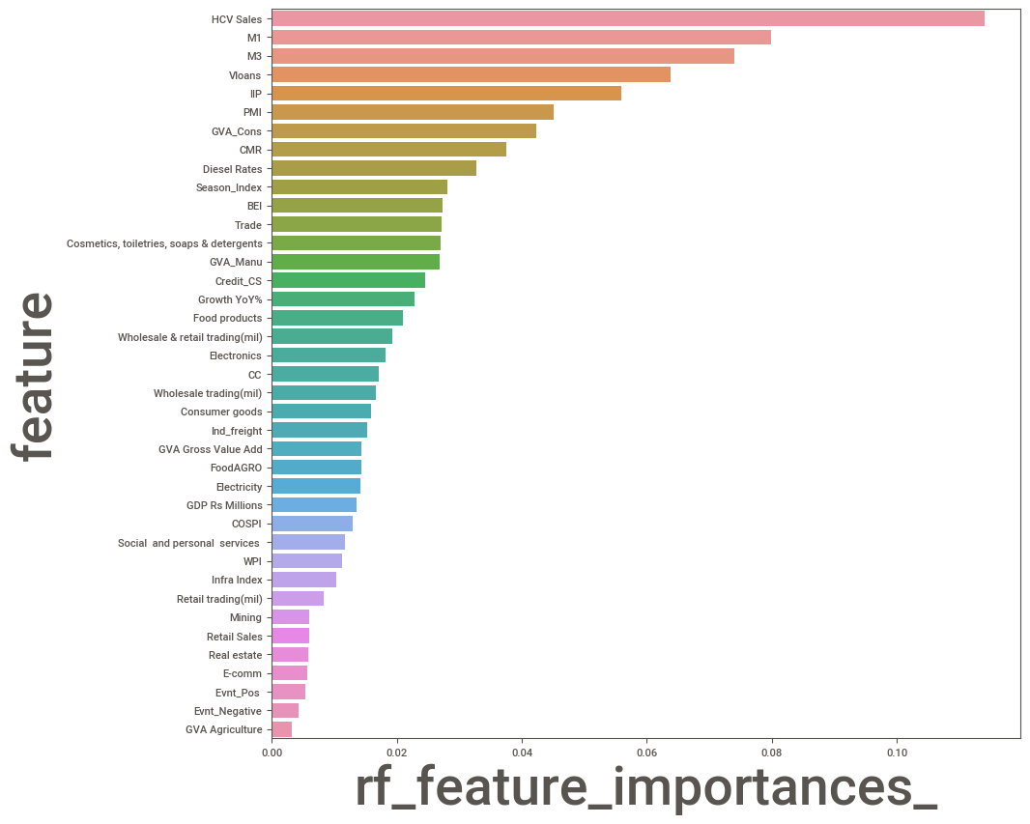
Comparison of number of indicators before and after feature importance analysis for LCV

Slide 14
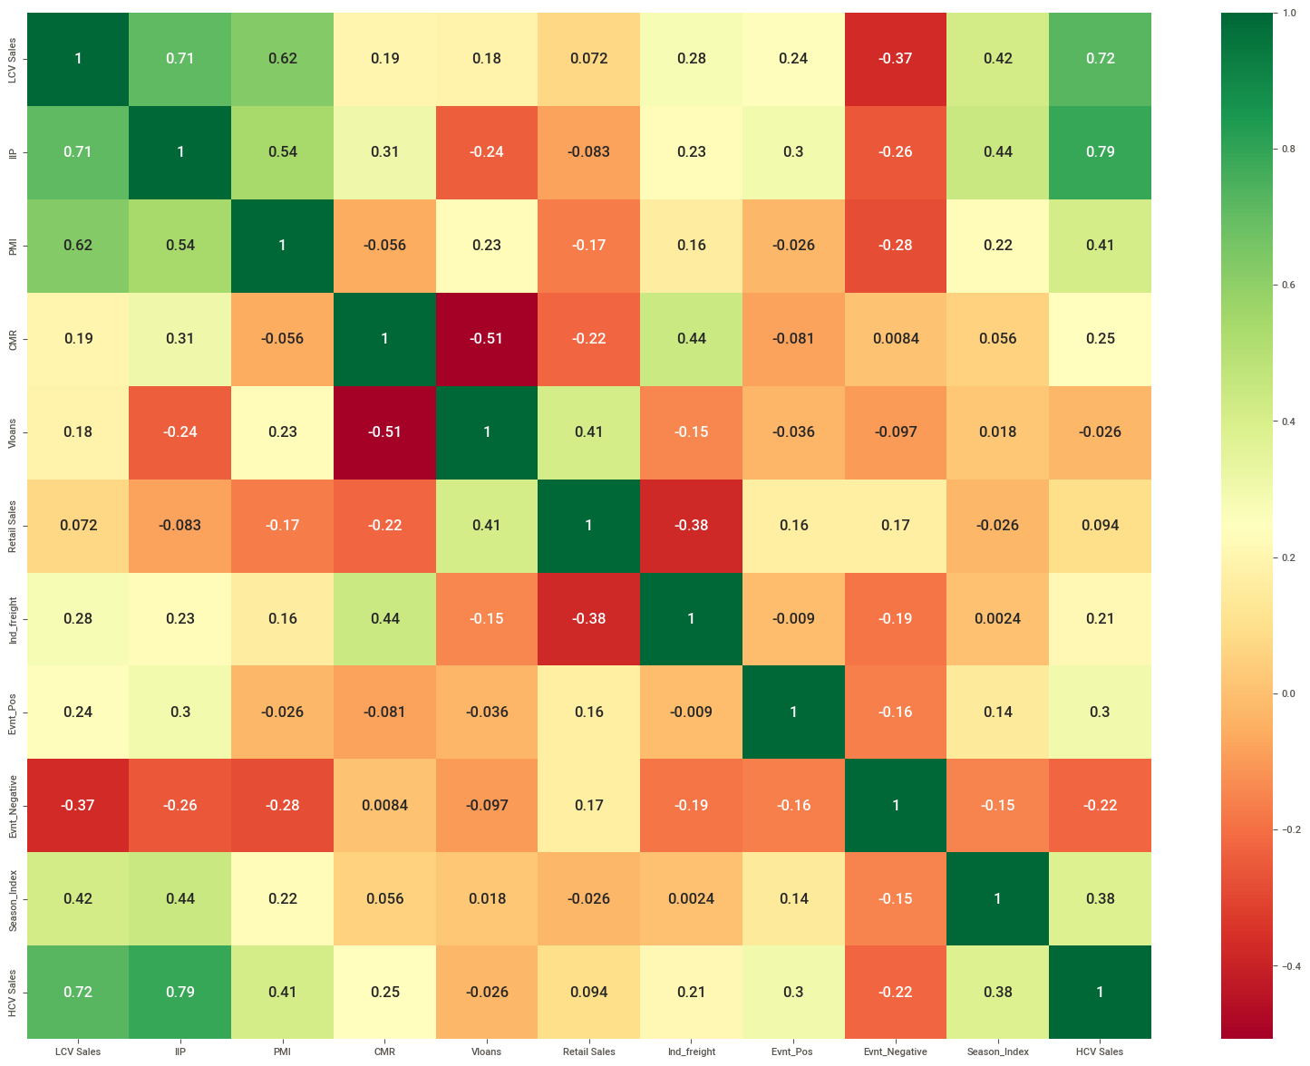
LCV
Heat map for correlation between indicators after feature importance analysis with most correlated indicators filtered out.

Slide 15
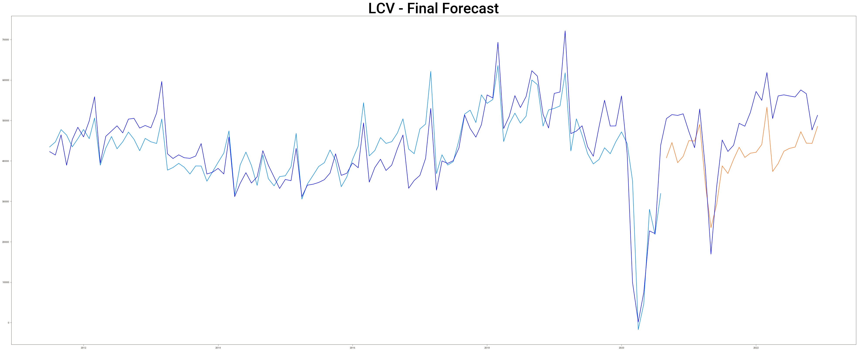
LCV final forecast obtained from model

Slide 16
LCV Monthly Sales Forecast Jan-2023 to Dec-2024

Slide 17
LCV Quarterly Sales Forecast Jan-2023 to Oct-2024

Slide 18
Final Forecasted Sales figures of LCV for Jan 2023- Dec 2024
Year-Quarter | Year-Month | Monthly Sales | Quarter Sales
2023-Q1 | 2023-01 | 62150 | 1,85,018
 | 2023-02 | 60459
 | 2023-03 | 62409
2023-Q2 | 2023-04 | 38162 | 1,32,077
 | 2023-05 | 41613
 | 2023-06 | 52302
2023-Q3 | 2023-07 | 51826 | 1,65,495
 | 2023-08 | 54134
 | 2023-09 | 59535
2023-Q4 | 2023-10 | 62075 | 1,78,451
 | 2023-11 | 56479
 | 2023-12 | 59897
Year-Quarter | Year-Month | Monthly Sales | Quarter Sales
2024-Q1 | 2024-01 | 61881 | 1,89,912
 | 2024-02 | 61688
 | 2024-03 | 66343
2024-Q2 | 2024-04 | 43788 | 1,38,572
 | 2024-05 | 43659
 | 2024-06 | 51125
2024-Q3 | 2024-07 | 56498 | 1,75,530
 | 2024-08 | 57046
 | 2024-09 | 61986
2024-Q4 | 2024-10 | 61923 | 1,84,792
 | 2024-11 | 60201
 | 2024-12 | 62668

Slide 19
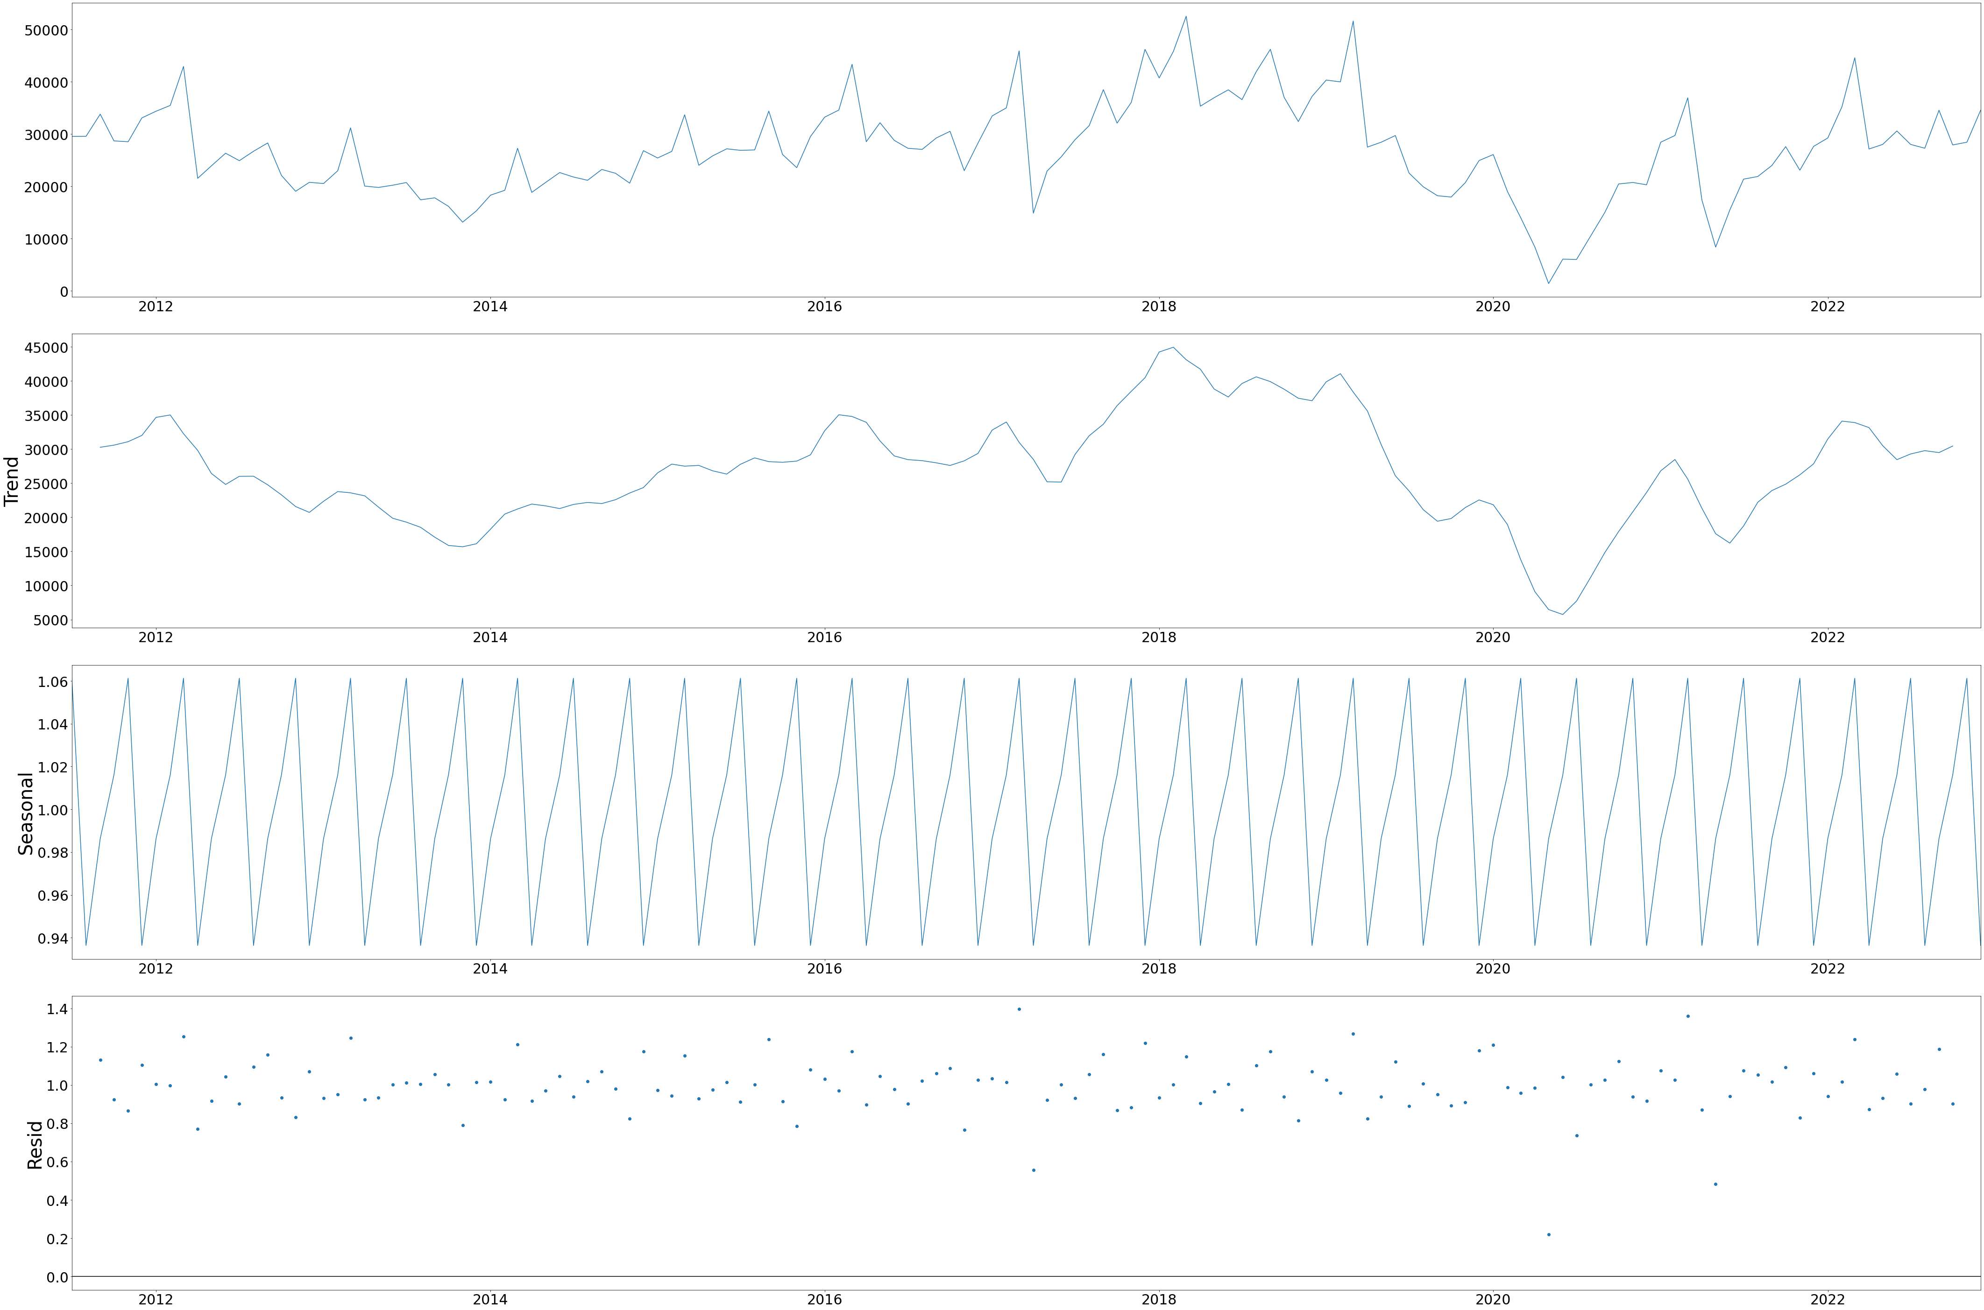
HCV Sales plot against time during the process of data cleaning and EDA for model train

Slide 20
HCV
Heat map for correlation between indicators before Feature importance analysis.

Slide 21
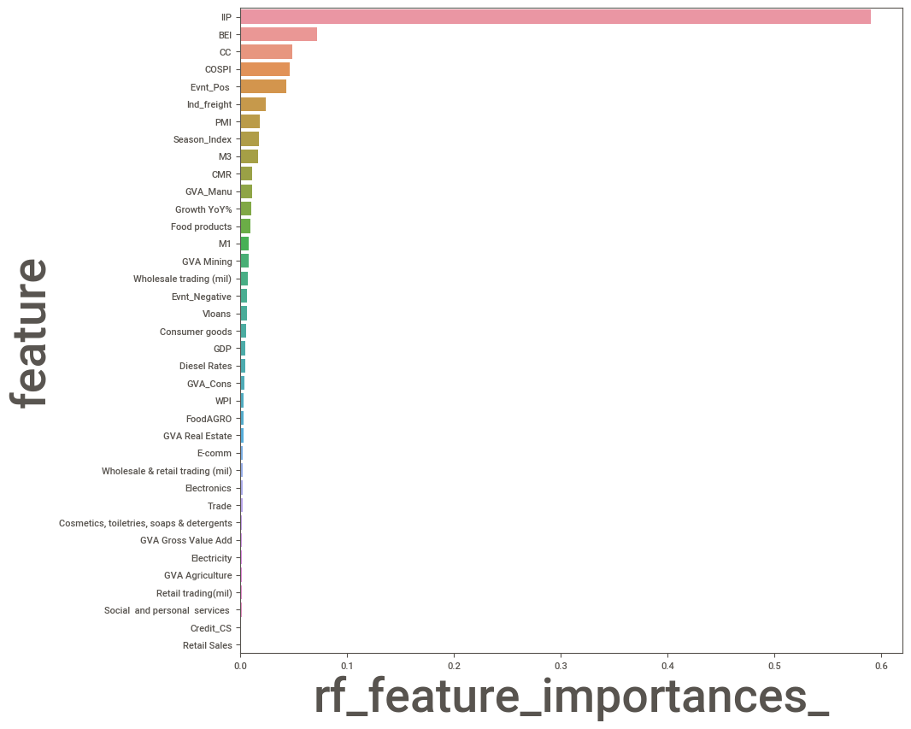
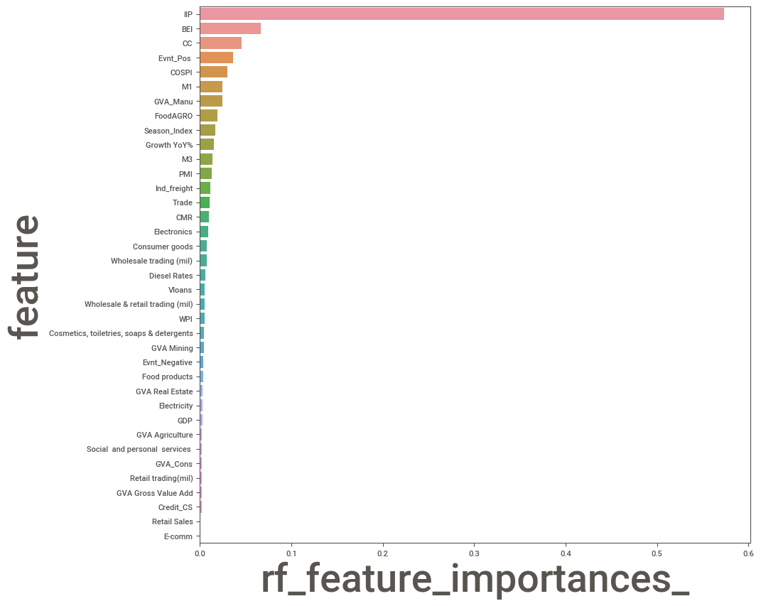
Comparison of number of indicators before and after feature importance analysis for HCV

Slide 22
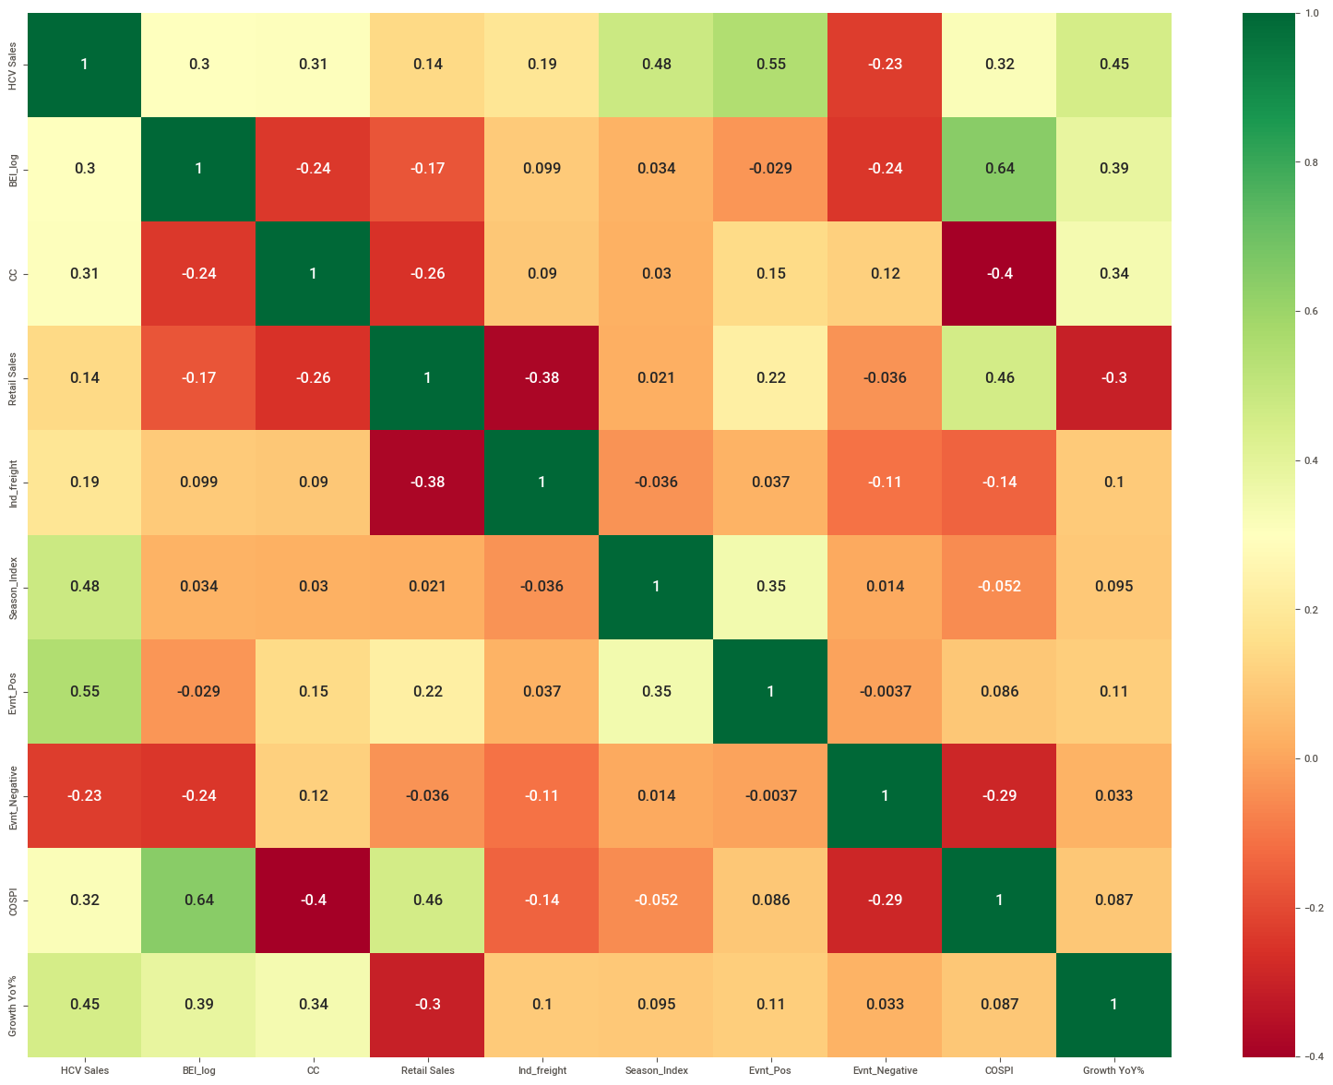
HCV
Heat map for correlation between indicators after feature importance analysis with most correlated indicators filtered out.

Slide 23
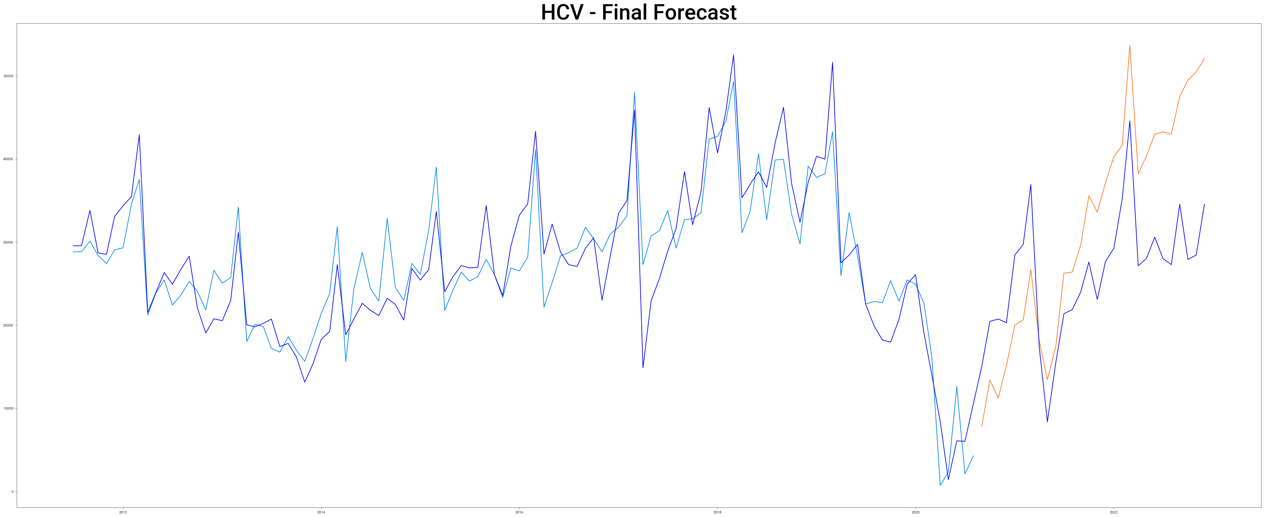
HCV final forecast obtained from model

Slide 24
HCV Monthly Sales Forecast Jan-2023 to Dec-2024

Slide 25
HCV Quarterly Sales Forecast Jan-2023 to Oct-2024

Slide 26
Final Forecasted Sales figures of HCV for Jan 2023- Dec 2024
Year-Quarter | Year-Month | Monthly Sales | Quarter Sales
2023-Q1 | 2023-01 | 36582 | 1,10,288
 | 2023-02 | 36044
 | 2023-03 | 37662
2023-Q2 | 2023-04 | 23148 | 79,181
 | 2023-05 | 24613
 | 2023-06 | 31420
2023-Q3 | 2023-07 | 30761 | 97,682
 | 2023-08 | 31541
 | 2023-09 | 35380
2023-Q4 | 2023-10 | 42725 | 1,14,752
 | 2023-11 | 35052
 | 2023-12 | 36975
Year-Quarter | Year-Month | Monthly Sales | Quarter Sales
2024-Q1 | 2024-01 | 38285 | 1,19,747
 | 2024-02 | 38248
 | 2024-03 | 43214
2024-Q2 | 2024-04 | 29361 | 91,672
 | 2024-05 | 28464
 | 2024-06 | 33847
2024-Q3 | 2024-07 | 37359 | 1,15,548
 | 2024-08 | 37494
 | 2024-09 | 40695
2024-Q4 | 2024-10 | 41537 | 1,22,611
 | 2024-11 | 39789
 | 2024-12 | 41285

Slide 27
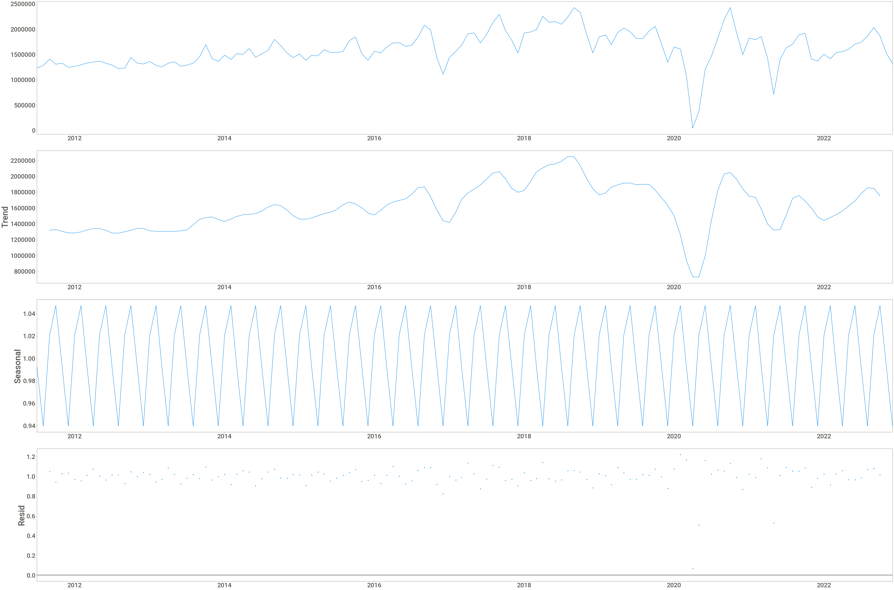
2W Sales plot against time during the process of data cleaning and EDA for model train

Slide 28
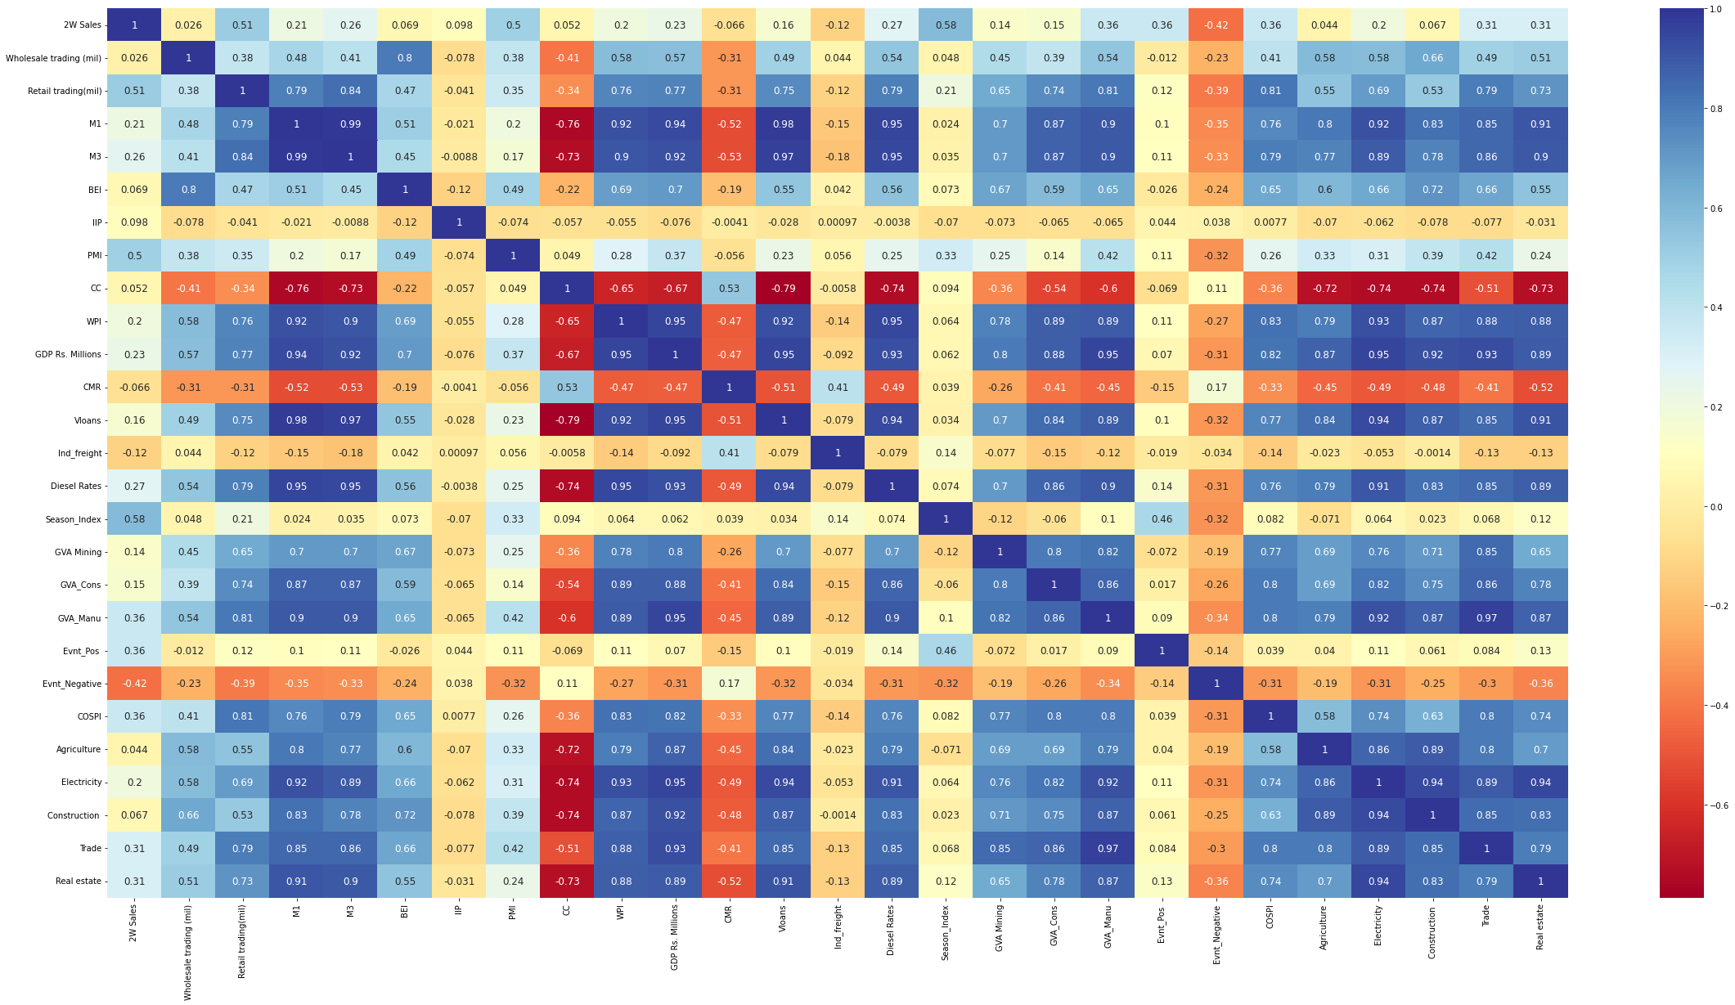
2W
Heat map for correlation between indicators before Feature importance analysis.

Slide 29
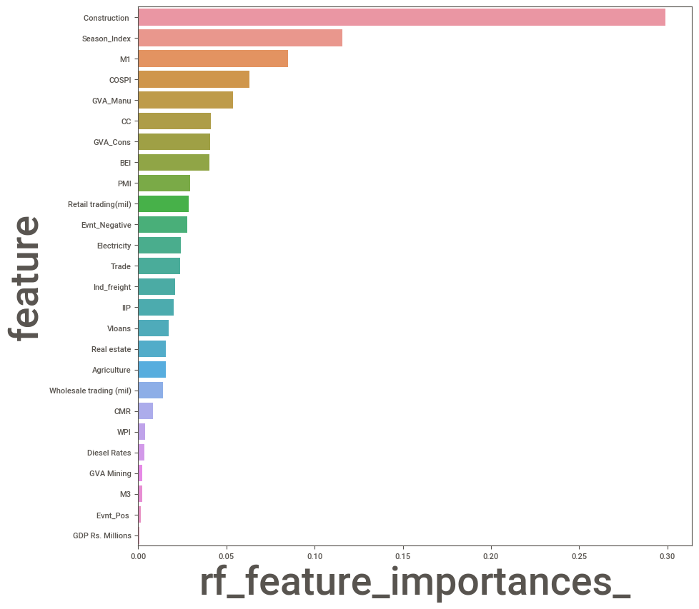
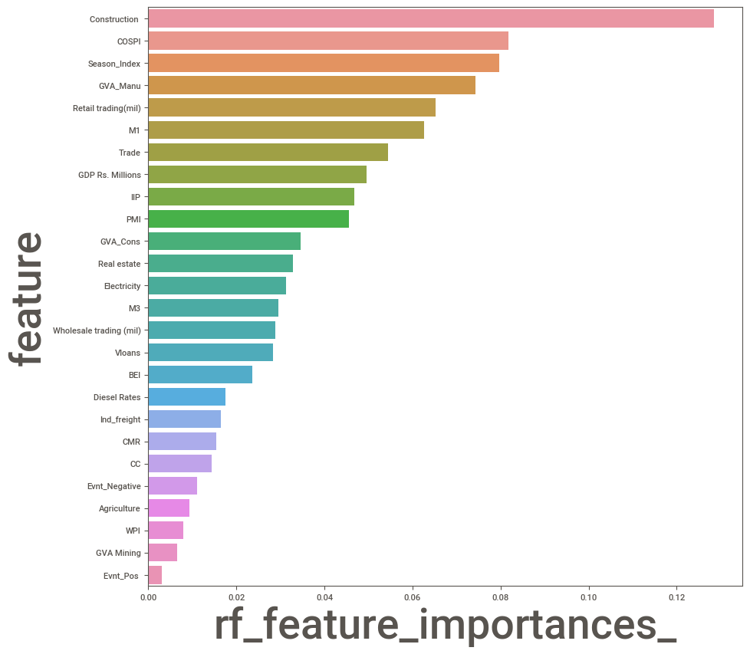
Comparison of number of indicators before and after feature importance analysis for 2W

Slide 30
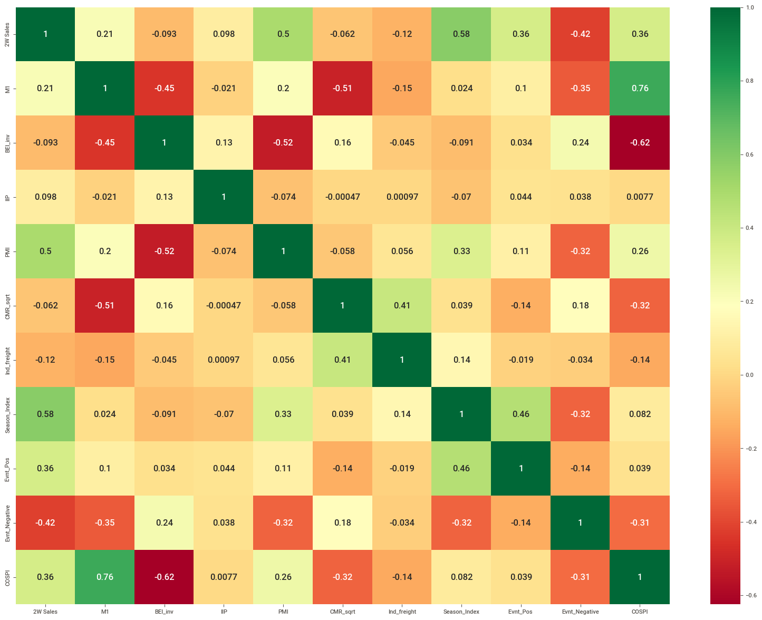
2W
Heat map for correlation between indicators after feature importance analysis with most correlated indicators filtered out.

Slide 31
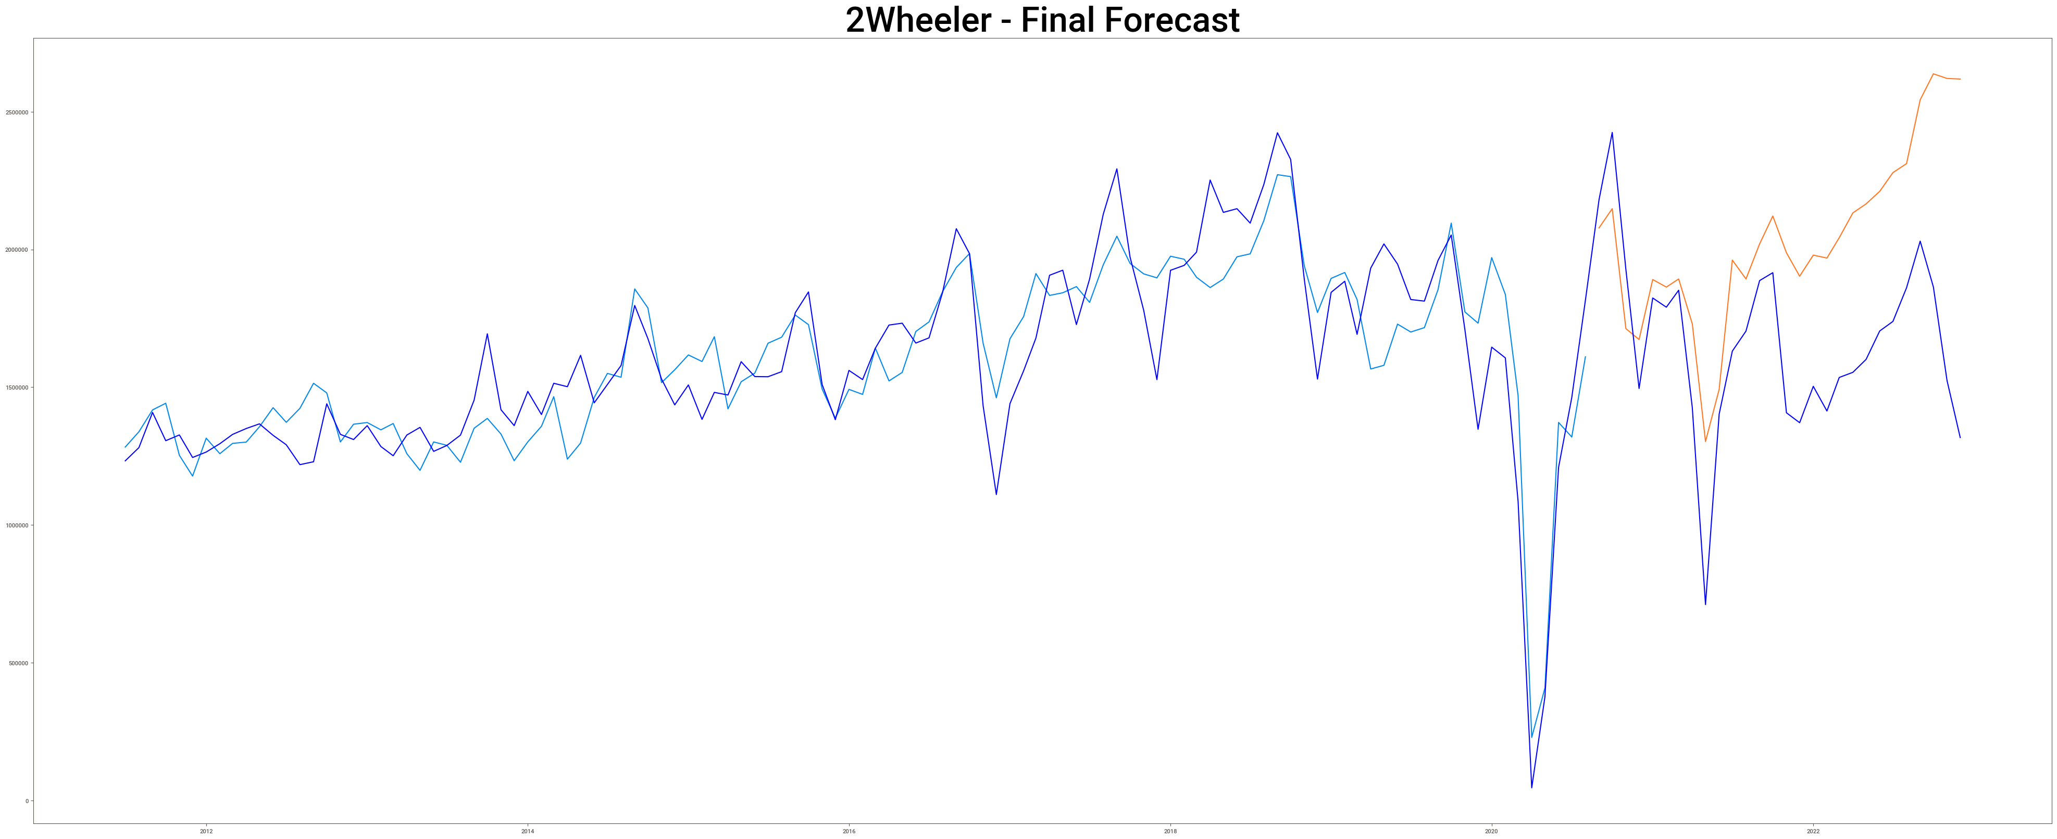
2W final forecast obtained from model

Slide 32
2W Monthly Sales Forecast Jan-2023 to Dec-2024

Slide 33
2W Quarterly Sales Forecast Jan-2023 to Oct-2024

Slide 34
Final Forecasted Sales figures of 2W for Jan 2023- Dec 2024
Year-Quarter | Year-Month | Monthly Sales | Quarter Sales
2023-Q1 | 2023-01 | 1993856 | 59,05,718
 | 2023-02 | 1918601
 | 2023-03 | 1993261
2023-Q2 | 2023-04 | 1178304 | 42,27,980
 | 2023-05 | 1344326
 | 2023-06 | 1705350
2023-Q3 | 2023-07 | 1757628 | 56,27,794
 | 2023-08 | 1837524
 | 2023-09 | 2032642
2023-Q4 | 2023-10 | 2228424 | 61,47,463
 | 2023-11 | 1921647
 | 2023-12 | 1997392
Year-Quarter | Year-Month | Monthly Sales | Quarter Sales
2024-Q1 | 2024-01 | 2066713 | 63,67,954
 | 2024-02 | 2055685
 | 2024-03 | 2245556
2024-Q2 | 2024-04 | 1507108 | 48,16,111
 | 2024-05 | 1523801
 | 2024-06 | 1785202
2024-Q3 | 2024-07 | 1987355 | 61,70,891
 | 2024-08 | 2007307
 | 2024-09 | 2176229
2024-Q4 | 2024-10 | 2210718 | 64,86,189
 | 2024-11 | 2115296
 | 2024-12 | 2160175

Slide 35
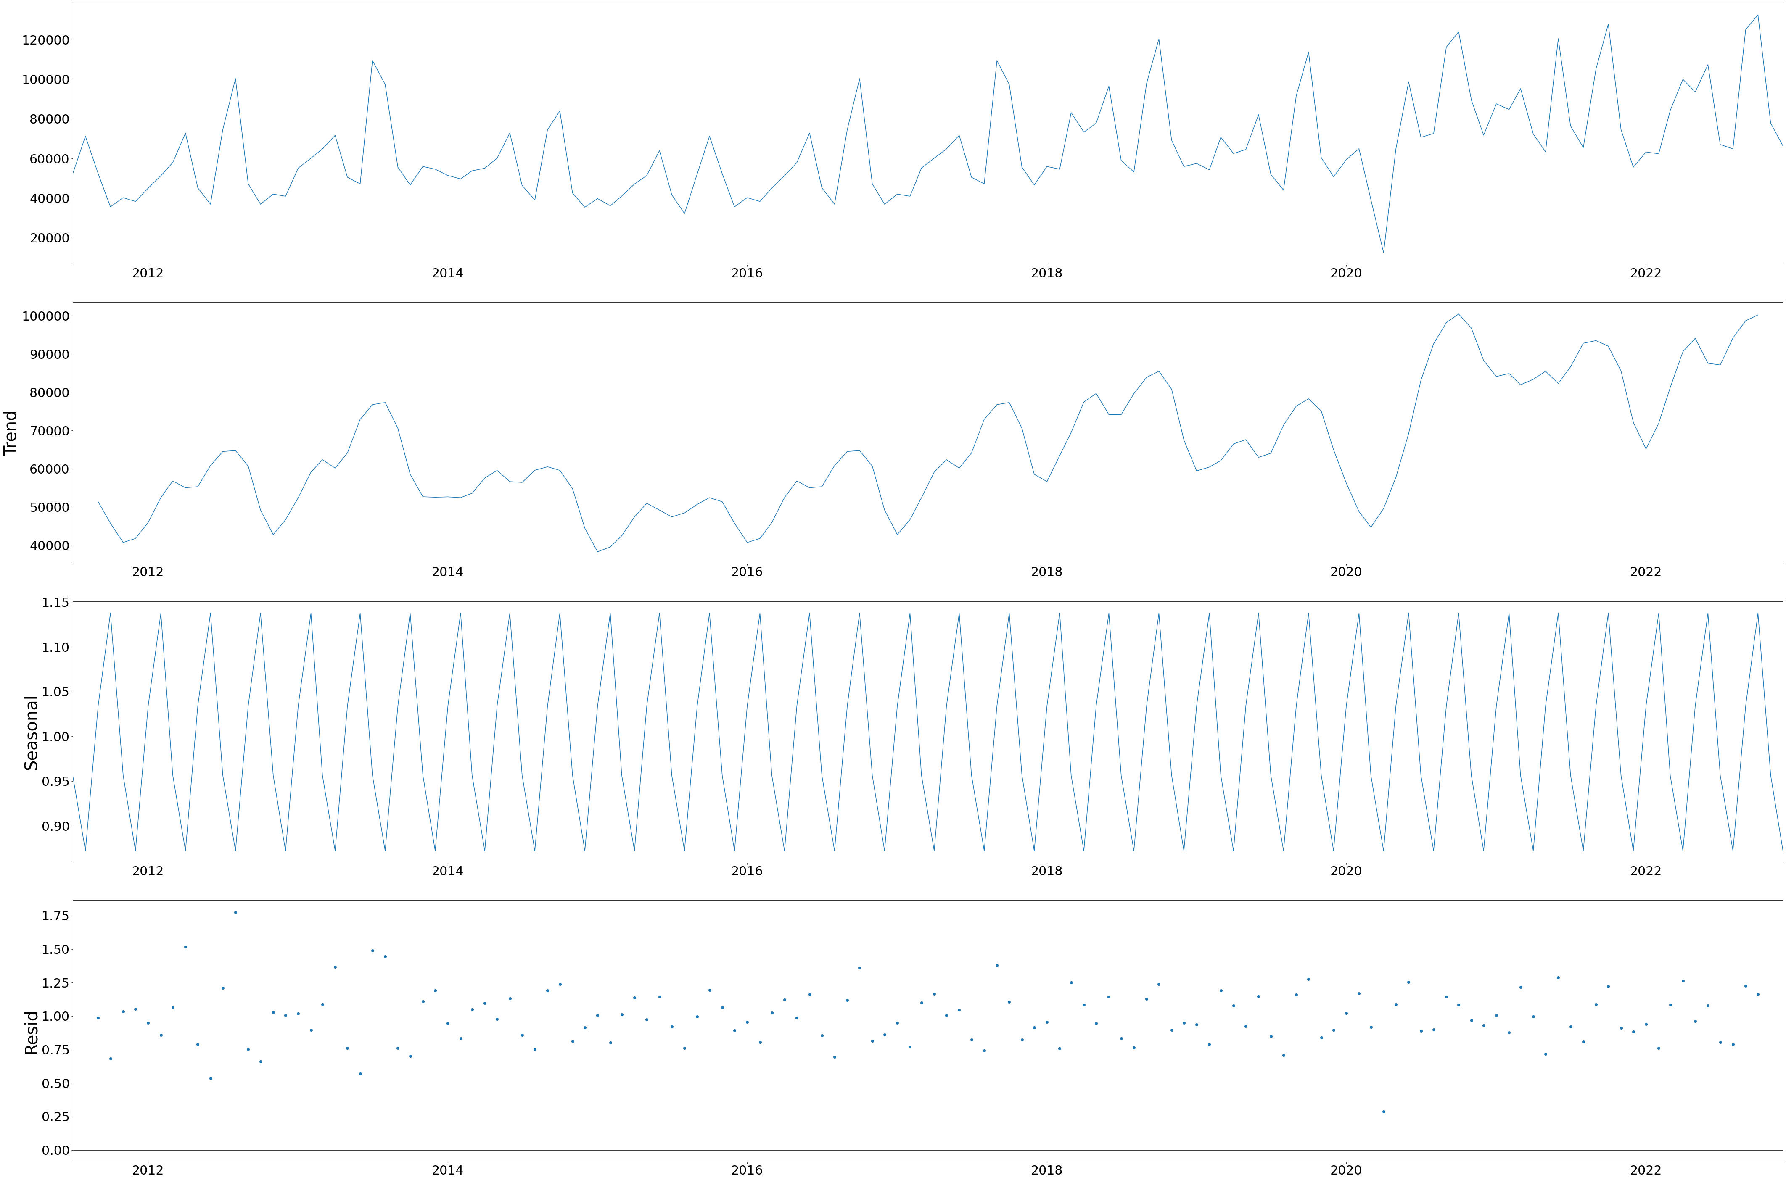
Tractor Sales plot against time during the process of data cleaning and EDA for model train

Slide 36
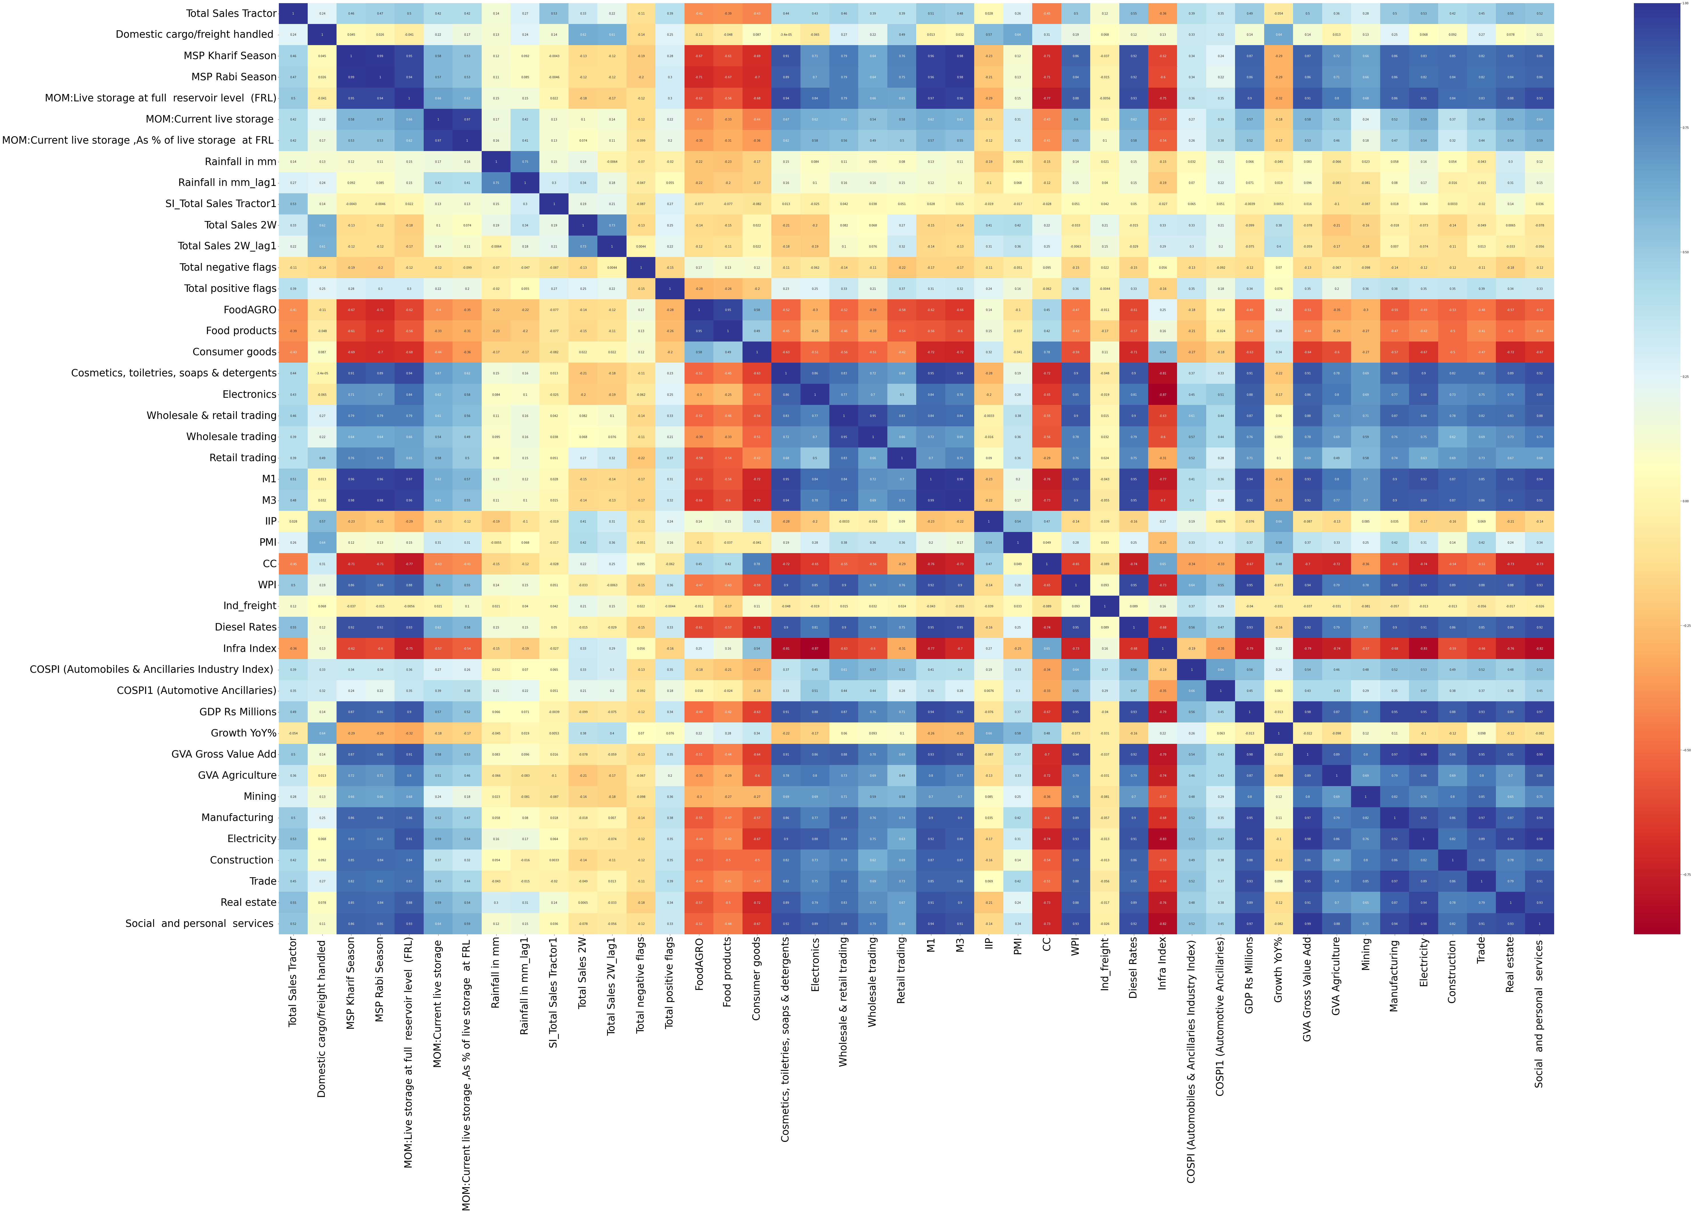
Tractor
Heat map for correlation between indicators before Feature importance analysis.

Slide 37
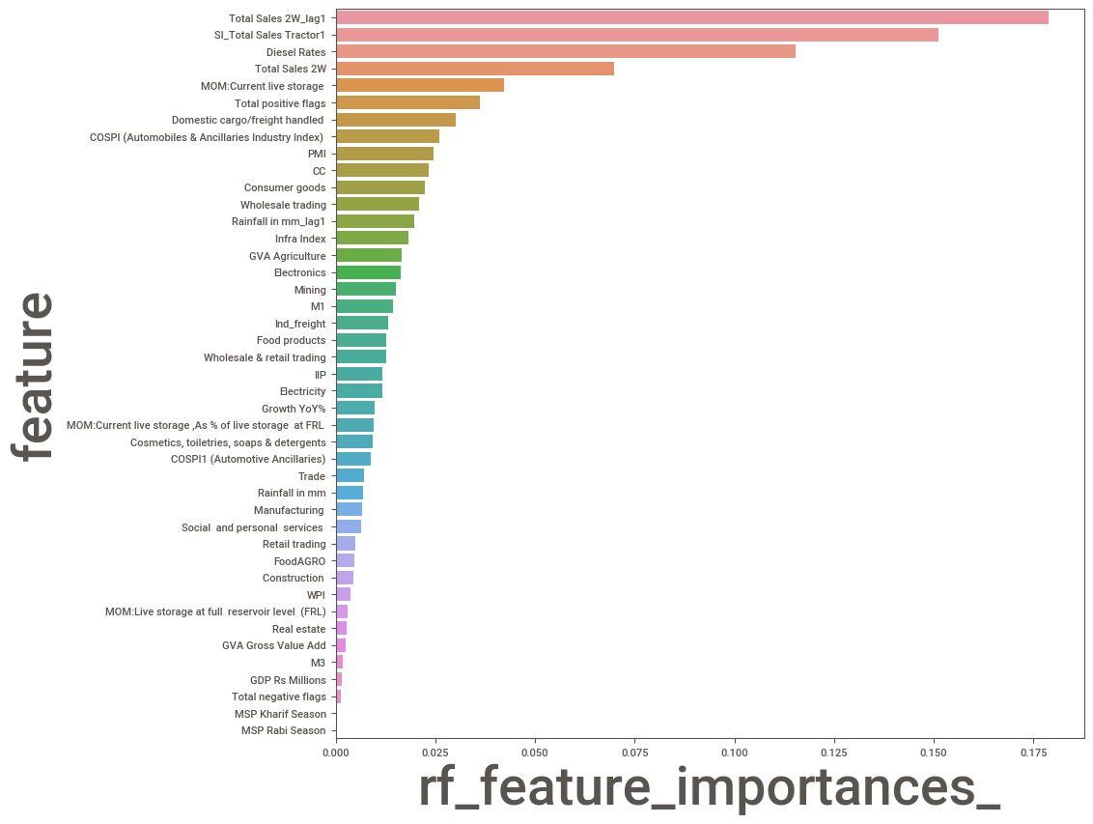
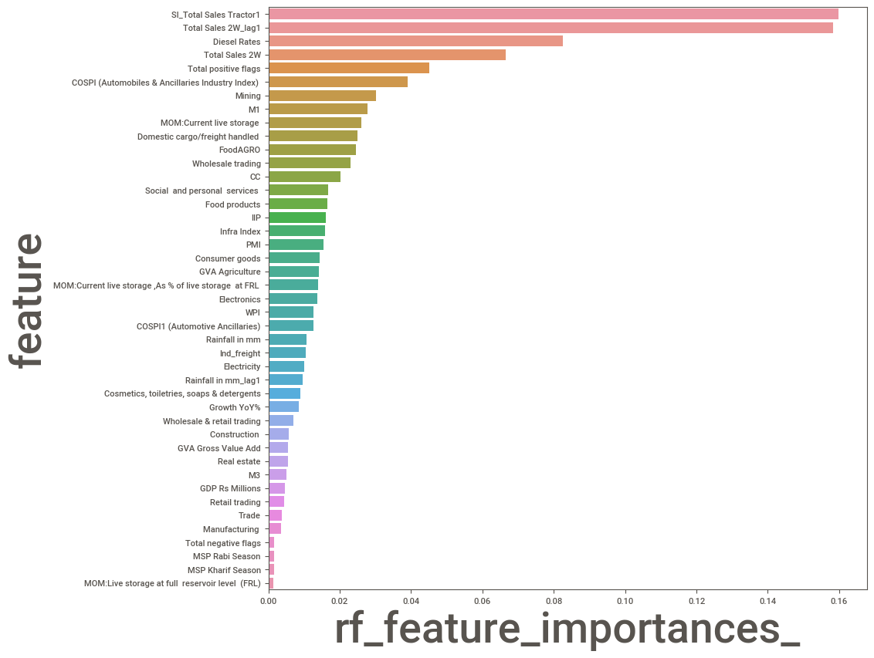
Comparison of number of indicators before and after feature importance analysis for Tractor

Slide 38
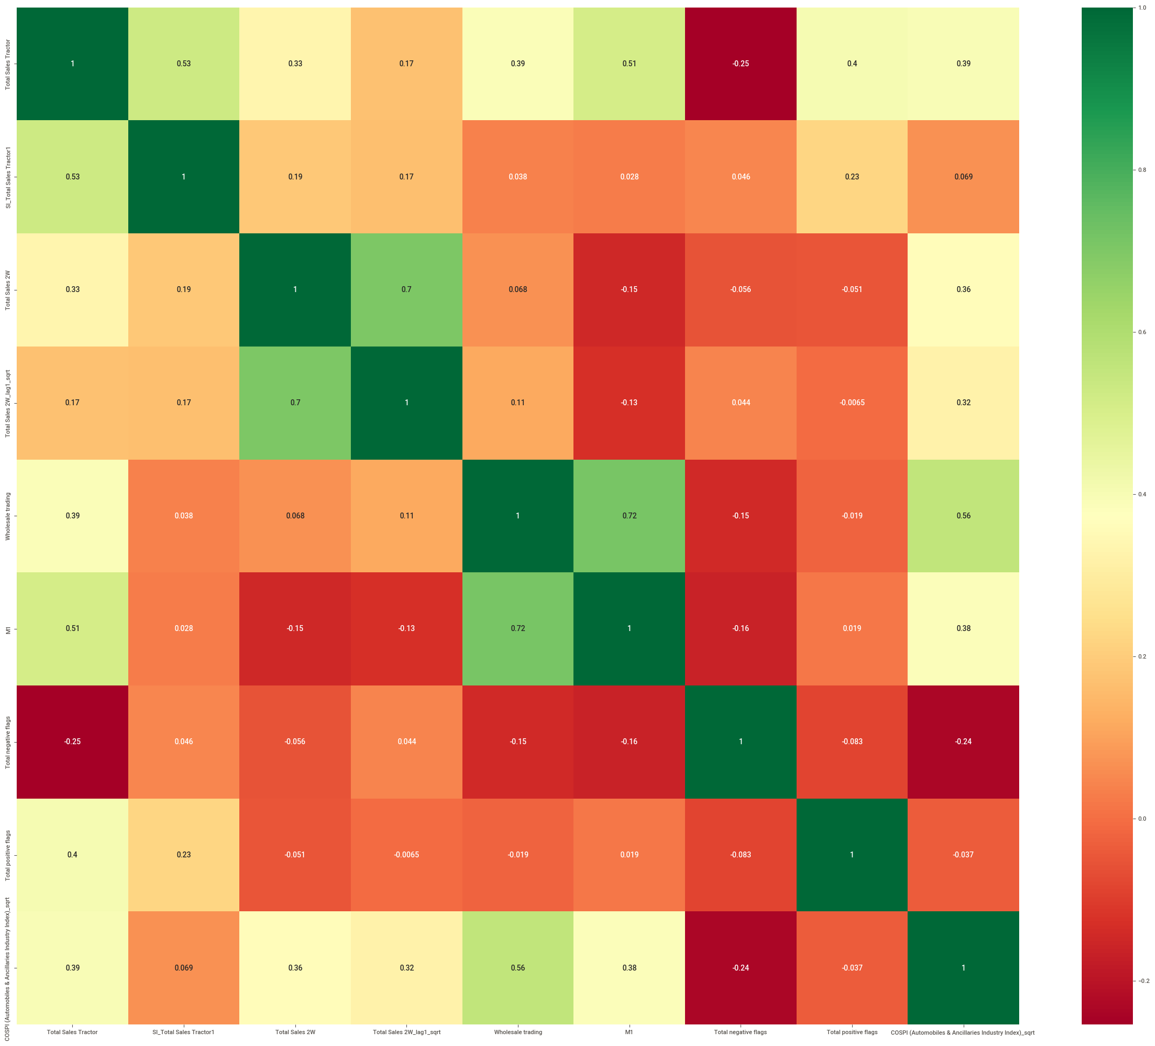
Tractor
Heat map for correlation between indicators after feature importance analysis with most correlated indicators filtered out.

Slide 39
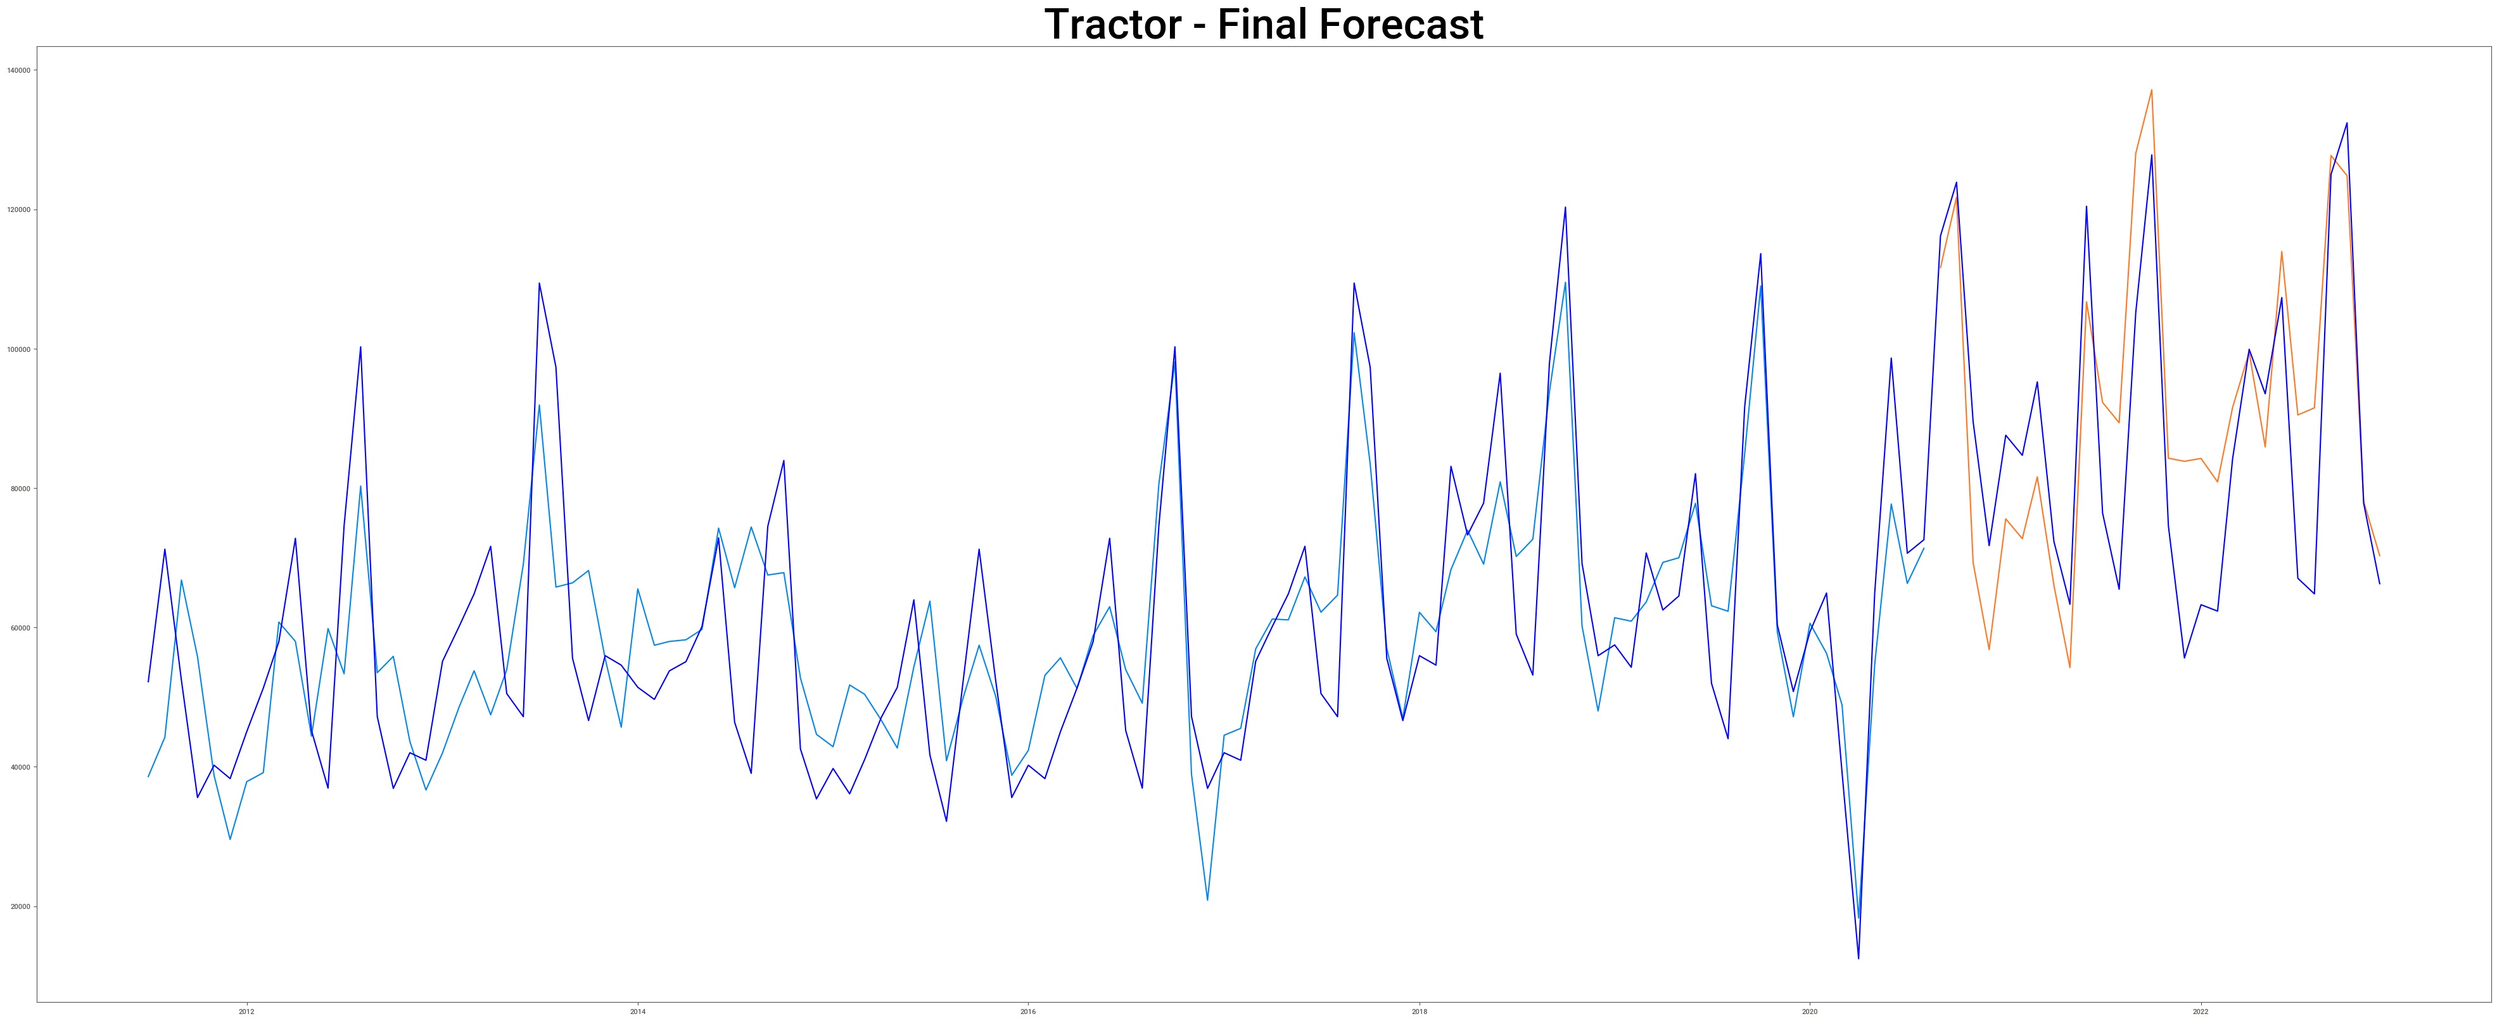
Tractor final forecast obtained from model

Slide 40
Tractor Monthly Sales Forecast Jan-2023 to Dec-2024

Slide 41
Tractor Quarterly Sales Forecast Jan-2023 to Oct-2024

Slide 42
Final Forecasted Sales figures of Tractor for Jan 2023- Dec 2024
Year-Quarter | Year-Month | Monthly Sales | Quarter Sales
2023-Q1 | 2023-01 | 84145 | 2,55,851
 | 2023-02 | 82096
 | 2023-03 | 89610
2023-Q2 | 2023-04 | 85202 | 2,73,979
 | 2023-05 | 85235
 | 2023-06 | 103542
2023-Q3 | 2023-07 | 92712 | 3,02,597
 | 2023-08 | 93847
 | 2023-09 | 116038
2023-Q4 | 2023-10 | 135322 | 2,98,740
 | 2023-11 | 85901
 | 2023-12 | 77517
Year-Quarter | Year-Month | Monthly Sales | Quarter Sales
2024-Q1 | 2024-01 | 88914 | 2,68,933
 | 2024-02 | 86415
 | 2024-03 | 93604
2024-Q2 | 2024-04 | 80815 | 2,61,863
 | 2024-05 | 81149
 | 2024-06 | 99899
2024-Q3 | 2024-07 | 97251 | 3,16,540
 | 2024-08 | 98363
 | 2024-09 | 120926
2024-Q4 | 2024-10 | 124687 | 2,97,351
 | 2024-11 | 90592
 | 2024-12 | 82072

Slide 43


